Slide 1

FIFTH CIRCUIT
2025 & BEYOND IN REVIEW
AKA
I read over 600 pages of cases so you don’t have to
Kiger Sigh, R&W Specialist

Slide 2

TOPICS
  First Amendment
  Second Amendment
  Third Amendment
  Fourth Amendment
  Fifth Amendment
  ACCA
  Sex, Guns, & Drugs
  Special conditions
  Restitution
  Miscellaneous
Notes:
We’ll go over the issue topics in order from pre-trial to appeal

Slide 3
Cases/issues not being reviewed
Cases involving only sufficiency challenges
Cases involving issues not normally litigated (2255 and specific offenses/enhancements)
Cases with trial issues – too factually specific
Some cases may have had multiple issues (Bruen, sufficiency, jury instructions, etc.), but focus is on the most analyzed issue only
Non-reported cases

Slide 4

1st Amendment

Slide 5
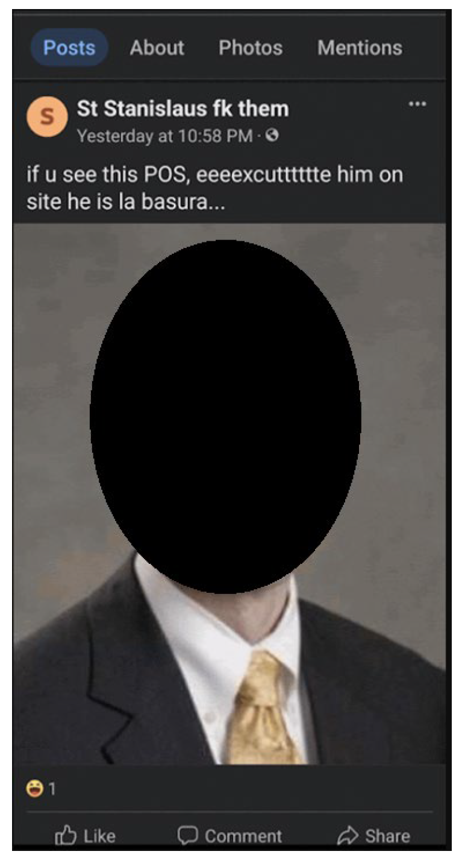
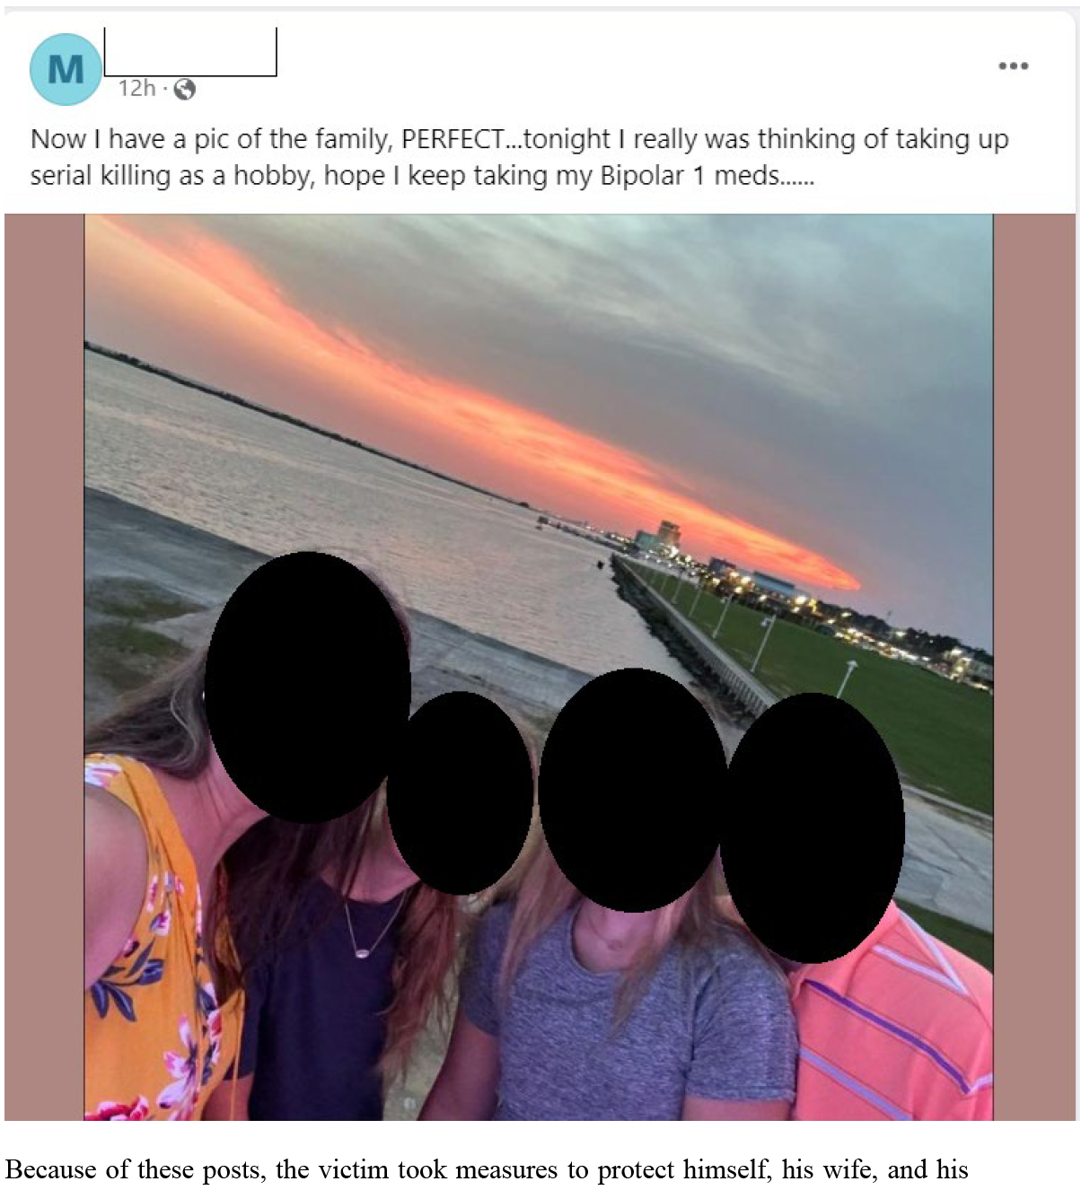
Burger, 170 F.4th 395, 396–410 (5th Cir. 2026) – threats in interstate commerce
Online gaming Roblox, in “Church” – people just argue
Burger made statements about guns, sacrificing his life, ISIS, and a music fest of Christians on the 12 of Shawwal – April 11 in Austin
District court said that Burger was merely role-playing as a character and no reasonable person could believe these were true threats; dismissed indictment
5th – reversed bc the district court's findings resolved a disputed factual question: whether the context of the Church experience would lead a reasonable player to believe that Burger was role-playing rather than expressing a sincere intent to commit violence (willfulness). Given that the district court's dismissal of each count depended on the “role-playing context” of the Church experience, the testimony from the tipsters would at the very least “provide a more certain framework for [the district court's] analysis.”
Jubert, 139 F.4th 484, 487–95 (5th Cir. 2025) – cyberstalking case
Cyberstalking case where victim fired Jubert as a camp counselor; 20 years later, Jubert posts on social media
  1. The defendant must use “the mail, any interactive computer service or electronic communication service or electronic communication system of interstate commerce, or any other facility of interstate or foreign commerce” at least twice. 18 U.S.C. § 2261A(2); see also id. § 2266(2).
  2. He must have acted “with the intent to kill, injure, harass, intimidate, or place under surveillance with intent to kill, injure, harass, or intimidate another person.” Id. § 2261A(2).
  3. Finally, he must “engage in a course of conduct that ... causes, attempts to cause or ... would be reasonably expected to cause substantial emotional distress.” § 2261A(2)(B).
Name calling at first, then gets more violent and threatening; made sure posts were seen
Victim’s family installed security cameras, installed panic button, and contacted the police
Court said – threats were specific and tracked the families locations; there was intent behind his posts and actions
Not facially unconstitutional
A statement is a “true threat” when: (1) “an objectively reasonable person would interpret the speech as a serious expression of an intent to cause a present or future harm”; and (2) “the speaker was subjectively aware of [the statement's] threatening nature.
to be a “true threat,” the statement, “when taken in context,” must convey a real possibility that violence will follow
Whether a statement is a true threat = question for jury

Slide 6
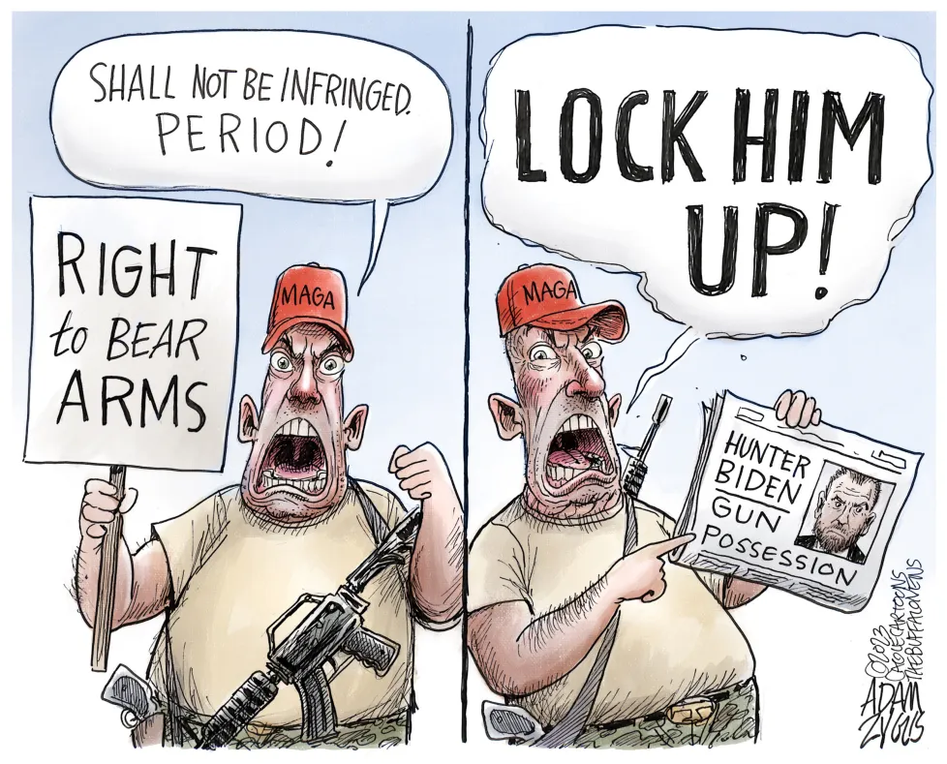
2nd Amendment

Slide 7
Clark, 148 F.4th 785
LA Agg Ass with firearm AND Clark was on probation when he was arrested
Russell, 136 F.4th 606, cert. denied, 146 S. Ct. 257 (2025)
TN agg assault and also affirmed under 2K2.1a1 for having 2 prior COV felonies
Morgan, 147 F.4th 522, cert. denied, No. 25-6677, 2026 WL 568341 (U.S. Mar. 2, 2026)
LA felony illegal use of weapon – drive by shooting
Schnur, 132 F.4th 863
Agg battery, burglary, and robbery
Betancourt, 139 F.4th 480, cert. denied, No. 25-5514, 2026 WL 135617 (U.S. Jan. 20, 2026
Agg assault for speeding
Simpson, 152 F.4th 611, cert. denied, No. 25-6813, 2026 WL 795166 (U.S. Mar. 23, 2026)
Texas law for evading arrest or detention with a vehicle = involves violence
Hudson, 161 F.4th 263, cert. denied, No. 25-6988, 2026 WL 1052005 (U.S. Apr. 20, 2026)
COV – AR robbery
Hernandez, 159 F.4th 425
DV misdemeanors or felonies – disarmed
Squire, 177 F.4th 614
Convicted drug trafficker in poss of firearm WITHIN THE HOME is still subject to being disarmed
Allam, 140 F.4th 289
18 USC 922q2a (poss of firearm in school district) aka attempted school shooting
Hembree, 165 F.4th 909
Simple poss of meth; reversed as applied
Cockerham, 162 F.4th 500, cert. denied sub nom. UNITED STATES v. COCKERHAM, EDWARD, No. 25-1029, 2026 WL 1640866 (U.S. June 8, 2026)
Failing to pay child support does not disarm a person (a debtor and thief are different; temporary v. permanent disarmament)
Judge Higginson dissent – long history of violence and drug distribution; *individualized assessment – see Mancilla (next slide)
Affirmed conviction
as applied
Bruen analysis – prior convictions must be similar to historical analogues
Notes:
Notice a trend = all predicate convictions include VIOLENCE
Betancourt and Simpson – the evading arrests were crazy – 107 mph, collided, threw passenger out window
*possible to challenge evading arrest – if the facts were better
SQUIRE
This case presents a novel question about whether the Second Amendment protects a convicted drug trafficker from being dispossessed of a firearm inside his home.
On February 15, 2024, a shooting occurred in New Orleans. Ten days later, officers with the New Orleans Police Department (“NOPD”) searched Squire's home pursuant to a search warrant alleging his involvement. In executing the warrant, NOPD officers found a handgun inside Squire's home. Tests confirmed that the firearm kept inside the home was not linked to the shooting, so the state charges related to the shooting were dismissed.
The essence of his argument is that disarming a person inside his home is antithetical to our historical tradition, which Squire says protects, rather than prohibits, arms possession inside the home. His theory is that the “ancient right” of self-defense, which derives from natural law, has special legal status in English common law and American law, most notably in the “castle doctrine.”
Today's holding is narrow. We conclude only that § 922(g)(1), as applied to a convicted drug trafficker (inherently dangerous crime) possessing a firearm inside his home, is consistent with this Nation's historical tradition of firearm regulation under Bruen. We do not decide whether the Second Amendment allows Congress to disarm individuals in the home based on convictions lacking a relevantly similar historical analogue to dangerousness, violence, or threats to public order. Accordingly, we AFFIRM the judgment of conviction and sentence.

Slide 8
Firearm related cases
McCree, 160 F.4th 641
922g1 and § 2K2.1b6B – 4 priors and caught with 5 crack rocks and gun while fleeing; 922g1 affirmed on priors
  Four-level increase if the defendant “used or possessed any firearm or ammunition in connection with another felony offense.” The enhancement automatically applies “in the case of a drug trafficking offense in which a firearm is found in close proximity to drugs…otherwise if the firearm ... facilitated, or had the potential of facilitating, another felony offense
McCree argued poss amount of crack was not drug trafficking offense; district court found 5 rocks was more than poss; affirmed
Judge Graves LONG dissent – 922 as applied = dismissal bc no facts were known about priors; due to no evidence of violence in predicates; 5 rocks = poss, not dist; facilitation standard
Mancilla, 155 F.4th 449
Distribution conviction – all distribution cases = dangerous felon and disarming is appropriate
*Judge Elrod concurrence – judges SHOULD REQUIRE individualized assessment of predicate offenses = context/temporal matters, but due to precedent this is not the case (this case was a rare occurrence – 10 year old distribution conviction with no firearm) – should he still be permanently disarmed? Maybe not
*Judge Graves dissent – judges SHOULD REQUIRE individualized assessment of predicate offenses = context/temporal matters (rule of orderliness from Reyes and Kimble)
Reyes, 141 F.4th 682
Multiple drug possession and distribution, gun, and fleeing convictions
Mitchell, 160 F.4th 169 (pre-Hemani)
18 USC 922g3 prior is not enough to disarm someone under 922g1 unless there is more drug abuse history in PSR or during arrest; Mitchell was not intoxicated at time of arrest – unlike in Contreras where he was intoxicated
Mitchell had a dangerous/violent criminal history BUT NO DANGEROUS convictions; not enough to disarm; must be conviction
Notes:
McCree – aggravated battery, poss of heroin, and 3 poss of gun charges = 922 affirmed on priors
crack cocaine rock and gun found in close proximity; gun with extended magazine, fled, discarded gun and drugs; DISSENT = factual
Mitchell – had extensive abusive criminal history, but no convictions; PSR noted he was merely a marijuana user over 3 years, but was not intoxicated during arrest

Slide 9
US v. Hemani, 2026 WL 1751710, at *1 (U.S. June 18, 2026) – unanimous for Hemani
922g3 - knowingly possessed a gun while being an unlawful user of marijuana every other day.
Hemani suspected of terrorism (never charged); search warrant found gun in closet
The prosecution did not allege that Hemani was intoxicated or using a controlled substance at the precise time he possessed the firearm. The government’s case rested SOLELY on his status as a regular drug user, not on simultaneous use and possession.
  Gov argued - The amount does not matter. The substance does not matter. Whether the person is dangerous does not matter; cited habitual drunkard
SCOTUS – historical ‘habitual drunkard law’ – only for those totally intoxicated or incapacitated, not frequent user
  922g3 strips gun rights automatically, the moment a person qualifies as an unlawful user, with no process at all.
  Additionally, the government's own conduct — directing federal prosecutors to curtail marijuana enforcement, permitting a multi-billion dollar marijuana industry to flourish under state law, and rescheduling marijuana from the most to a less restrictive federal drug schedule — fatally undermines its claim that all regular drug users are categorically and unusually dangerous people.
Justice Thomas concurred, arguing that §922g likely exceeds Congress's power under the Commerce Clause because regulating firearm possession solely on the basis that a gun once crossed state lines is not a regulation of interstate commerce.
Justice Jackson, joined by Justice Sotomayor, concurred, arguing that Bruen's history-and-tradition framework is unworkable and that courts should return to "means-end scrutiny" — directly weighing the government's interest against the burden a law places on Second Amendment rights.
Justice Alito, joined by Justice Kagan, concurred in the judgment only, arguing the case should rest on the single, narrow ground that the government's historical analogues targeted only the truly incapacitated, not regular users, without reaching the majority's additional analysis of purpose mismatches, procedural differences, or the government's own regulatory choices.
The government cannot disarm a person simply by naming a permissible reason. A government could do that in any case to defeat a right. What it must do is prove that the permissible reason it names is the reason it acts on, and to tie that reason to the person it seeks to disarm.

Slide 10
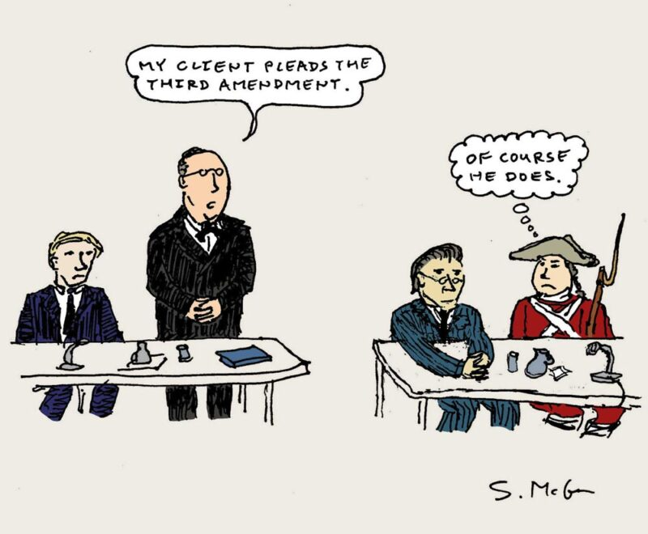
3rd Amendment

Slide 11
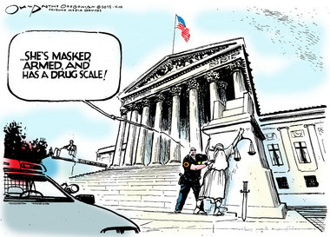
4th Amendment

Slide 12
Terry Stops
Larremore, 150 F.4th 463
Truck pulling trailer consensually pulls over (no traffic violation) and officer leans on truck, says hang on, and questions; none of these are seizures or unconstitutional
*Judge Elrod – dissent – “hang on” was seizure and should have suppressed
Ducksworth, 168 F.4th 764
Traffic stop, driver lied about having a firearm; officer patted a firearm between legs, passenger is sitting and the officer “imputes belief” that passenger has one too; passenger is paralyzed and cannot get out of vehicle, officer Terry pats and finds firearm between legs
“beyond folly” for officers to ignore hidden firearms on driver and passenger
Garcia, 170 F.4th 376
Police responded to BOLO about shooting from a black SUV and missing taillight with paper license from multiple sources
Can BOLO = RS for stop? YES – very detailed and collective knowledge doctrine
Davalos, 165 F.4th 928
Traffic violation, Davalos pulls into his own driveway; officer tells Davalos to walk to him, officer walks to vehicle knocks on tinted window, smells marijuana, and notices window has been tampered with; (car door was left open)
There was RS to stop, exigent circumstance – officer safety, and marijuana smell plus winder tamper = PC to search
Driveway may have been curtilage, but officer safety, PC , and plain view
Notes:
Larremore – traffic interstate, officer Uturns and speeds after him, Larremore just pulls over, but is not blue lighted; begins questioning him – where he was going, what he was doing; saw open container of beer; Larremore gets out of truck and deputy asked to get inside the trailer; lots of inconsistent answers to officer questions; officer asks to open trailer, larremore finally says go get bolt cutters and admits to having cousins inside
Elrod – every fact from opposite view

Slide 13
Weaver, 171 F.4th 780
Judge Mills dismissed SW and no GF (boilerplate language, no drug test, no corroboration)
Argued there was no information on the CI re reliability or veracity – only the 3 buys
Riojas, 139 F.4th 465
Traffic stop and marijuana smelled by officer; pled guilty unconditionally, but wants to appeal
Defendant argued traffic stop in briefing; Gov responded and did not bring up waiver
Court held the gov waived the waiver, but still found PC to search the vehicle
Ponce, 168 F.4th 784
Border Patrol exception allows traffic stop, questioning, and visual inspection; search, however, is still subject to consent or PC to search
Consent was to look inside trunk, not the speaker box
Court – consent allowed search where any reasonable person may believe contraband is
Leonard, 167 F.4th 284
Police responded to man “in nothing but torn underwear” bleeding on ground; man’s house was nearby, officer went and looked inside and saw guns and drugs, THEN got SW (SW was valid, but officer got information unlawfully); district court suppressed evidence
Gov appealed – good faith, “close enough (doctrine) to the line of validity” = “susceptible to valid criticism, but it is what it is”
  Evidence is admissible if the officer's conduct that led to the information in the warrant affidavit was “ ‘close enough to the line of validity’ that an objectively reasonable officer ... would believe that the information” gathered “was not tainted by unconstitutional conduct.”
  That is, the warrant itself was valid, but the information the officer used to obtain the warrant was acquired illegally.
Officers had exigent circumstances to enter house – injury, protective sweep, or identify shooter
Judge Oldham dissent – “Close” only counts in horseshoes and hand grenades—not in evidentiary suppression hearings. I would require criminal defendants to show that the officer who illegally discovered the information used to obtain a warrant violated clearly established law. Otherwise, the good faith exception applies and officers may rely on the warrant.
Notes:
Riojas = not the way we do it; seems like they offer a conditional or unconditional PA, rather than a “waiver of appellate rights” in PA
Leonard = Evidence is admissible if the officer's conduct that led to the information in the warrant affidavit was “ ‘close enough to the line of validity’ that an objectively reasonable officer ... would believe that the information” gathered “was not tainted by unconstitutional conduct.” Id. at 528. That standard is susceptible to valid criticism. See post, at 292–93 (OLDHAM, J., concurring). But it is what it is.
It doesn't matter whether the officers entered Leonard's home to clear the area of Leonard's possible attacker, identify other potential victims of an attack, or to find someone with information that could help with Leonard's medical care.

Slide 14
Johnson, 163 F.4th 933
SR violation led to arrest and warrantless search of vehicle; GF was in car and on scene to drive
Protective sweep doctrine – allowed if reasonable belief defendant was dangerous and weapon is accessible; same for passenger
GF had criminal history, but nothing to indicate she was dangerous at that point in time
Police must point to contemporaneous facts to justify danger
Judge Haynes dissent – would a RPP be warranted that his safety was in danger – felon, lives with def, suspected gang member
*But see August 136 F.4th 595
Officers respond to gunshots; backyard is cluttered with junk (place to hide weapon); officer detained him and swept the yard and car
SW granted for house
Sweeping of the backyard AND his house was reasonable – facts led to affirmance (possible 3rd party and contradicting statements)
Wilson 1, 143 F.4th 647
LA statute for concealed carry = district court found the ‘poss of concealed firearms’ as presumptively illegal and therefore the presumption allowed officers to stop anyone in LA
USMS approached Wilson and saw a bulge in the waist area; Terry seized
Can police Terry stop a citizen based solely on the fact that he is carrying a concealed gun – NO (6 reasons), but affirmed on other grounds
*other reasons to stop – wanted to talk to him about fugitive friend involved in drug shootout
*Judge Graves dissent – if there were other reasons, then why spend time on the issue?
REVERSALS and GOOD CASE LAW
Notes:
Johnson – She did not, for example, disobey the officer's instructions, display any hostility toward the officers, or motion toward the vehicle when Johnson encouraged her to return it to the driveway.
Wilson 1 –
Louisiana law prohibited “[t]he intentional concealment of any firearm, or other instrumentality customarily used or intended for probable use as a dangerous weapon, on *656 one's person.” LA. REV. STAT. § 14:95(A)(1)(a).4 But the prohibition did “not apply to a person with a valid concealed handgun permit.” Id. § 14:95(A)(1)(b). Permits for concealed handguns “issue[d] ... to any Louisiana resident” who met the statutory requirements. Id. § 40:1379.3(A)(1). And a “permittee armed with a handgun” must “notify any police officer who approaches the individual in an official manner or with an identified official purpose that the individual has a weapon on his person, submit to a pat down, and allow the officer to temporarily disarm him.” Id. § 40:1379.3(I)(2).

Slide 15
Wilson 2, 153 F.4th 478
Waffle house altercation, Wilson pulls out gun; 2 weeks later SW issued for GFs apt. for separate investigation with WH incident attached
SW was bare bones and threadbare; no nexus established between offense and place to be searched; SW was lacking in PC
PC to arrest for WH incident is NOT PC to search gf’s house without any suspicion of gun being there (needs factual bridge)
Judge Willett hated affirming the suppression; Judge Ho dissented
But see Norman, 129 F.4th 874
SW for Norman’s apt where a drug transaction took place (valid) AND a nearby house based on drug transaction where he slept (invalid); argued bare bones due to lack of nexus with the house
  Included 2 pgs of texts re drug transactions and said – meet at apt and residence and travelled between apt and house multiple times at night and during day after transactions
District court suppressed the house warrant evidence based on lack of nexus and bare bones
REVERSED dismissal bc texts did talk about residence and “inference” that drugs would be kept there

Slide 16

Villarreal, 16 F.4th 364
Conchas-Mancilla, 173 F.4th 200
I’m a good boi
Villareal was traffic stopped for tag, no DL or insurance, and consented to a K9 sniff; drugs and gun found; argued unreasonably prolonged
would have been impounded/inventoried = inevitable discovery (challenge the impound policy)
Conchas-Mancilla came to border patrol and K9 alerted; sent to secondary inspection where K9 alerted and drugs found hidden
Question – alert v. indicate by K9
An alert is “an instinctual change in body posture that occurs when the canine first encounters a trained odor.” An indication “is a trained behavior—such as sitting, pointing, scratching, or biting—that occurs after the ‘alert,’ when the canine detects contraband or people.”
Based argument on Keller FN - trained and certified dog performing its trained behavior [i.e., an indication] is sufficient by itself to create probable cause for a search,” but the same dog “exhibiting a distinct behavior that is innate or instinctive but not trained [i.e., an alert] may create probable cause in combination with other evidence or testimony
Court said ‘totality of circumstances’ test wins
Notes:
First – this was a border stop – no reasonable suspicion necessary – valid detention, but still need additional RS to extend the seizure
Court found persuasive that K-9s could detect humans buried under rubble and alert and that Bak had not alerted for a few weeks when there were other drivers pulled over and not just responding to cues; also Bak and officer had above-average scores

Slide 17
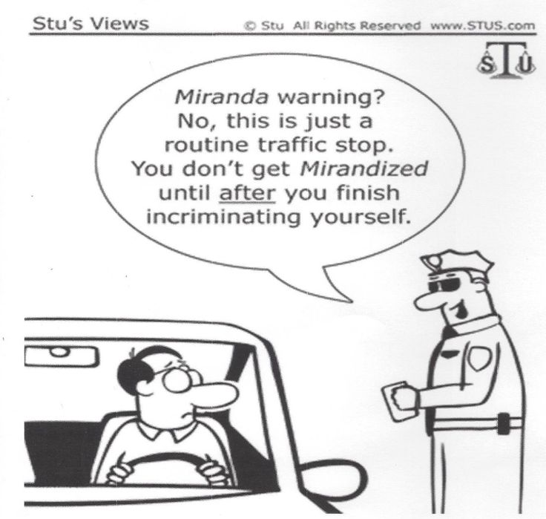
5th Amendment

Slide 18
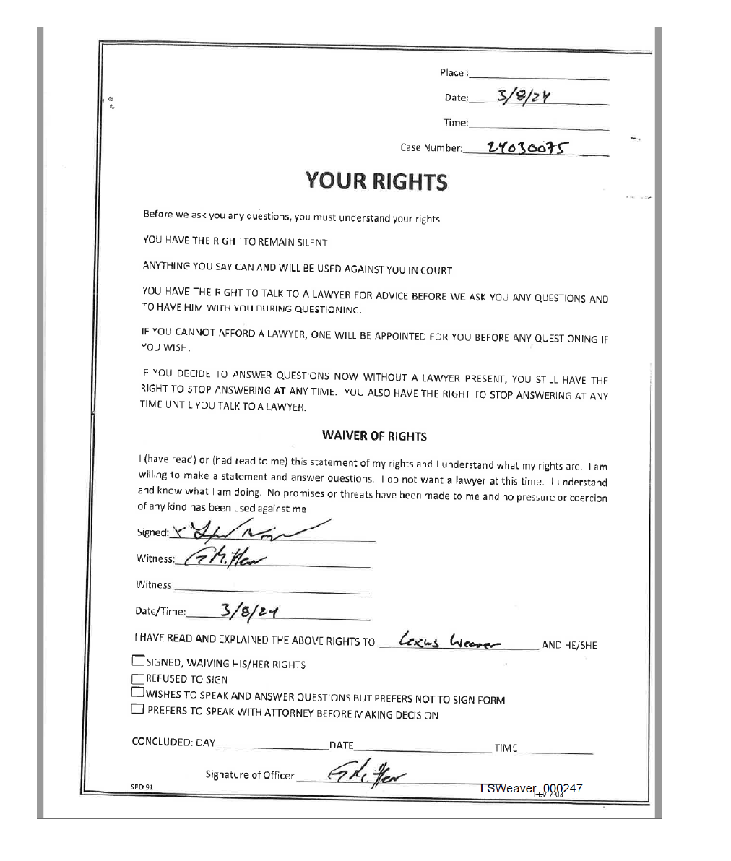



Weaver, 171 F.4th 780
After Weaver was arrested, officers interrogated him and read the rights, BUT did not read the Waiver of Rights section
Slid the document across and stated, “Just sign this document saying I read the rights to you”
  Weaver signed the form under the pretense that it was an acknowledgement that Officer Mittan read his Miranda rights to him.
  Officer Mittan did not read the waiver section to Weaver, and Weaver did not appear to read the waiver section.
  Consequently, Weaver thought he was acknowledging being informed of his rights while the signature, according to the form, represented an express waiver of his rights.
  This was deceptive, as Officer Mittan acknowledges, negating the voluntariness of his express waiver. Although Officer Mittan assures that he was not trying to deceive Weaver, “the state of mind of the police is irrelevant to the question of the intelligence and voluntariness of [the suspect's] election to abandon his rights.”
Explicit waiver invalid, but was this an implicit waiver since Weaver just began talking?

Slide 19
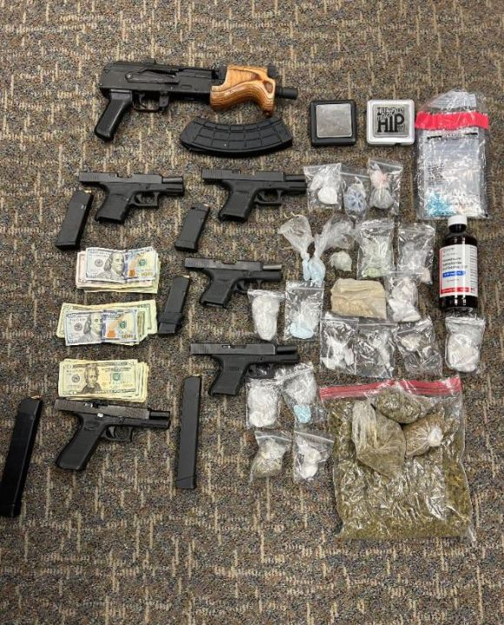
Sex, Guns, and Drugs
Sentencing Enhancements

Slide 20

Lopez, 168 F.4th 316
2G2.2b3B - 5-level pecuniary gain = affirmed; implicit agreement to trade CP for CP; chatroom for CP (worse than P2P network); P2P does not qualify because a pure download does not show intent to receive pecuniary gain; these chat rooms do show intent
2G2.2b5 5-level increase for pattern of sexual abuse or exploitation of a minor – vacated bc there were not 2 prior instances (current offense does not count as one); gov may present evidence at remand
Fucito, 129 F.4th 289
Fucito chatting with UC cop and traded CP for possible meetup with minor;
2G2.2b3B – argued no agreement; Court found trading CP for meetup satisfied; no actual gain is not required
600 images enhancement – can they include duplicates? YES – each image counts; regardless of duplicate or copy
Quintanilla-Matamoros, 164 F.4th 366
Tier I or Tier III offender – categorical approach; look at state conviction to see if conduct is broader - TX 22.011
Can be convicted under Texas statute by having consensual intercourse with a child under 17 years old, but not necessarily under 18 U.S.C. §§ 2241 or 2242; does not qualify as Tier II either; this is a Tier I offense (least severe)
Parties agreed to this Tier reduction…Judge Ho concurred in judgment, but not to binding precedent since the reduction was agreed by parties
Jimenez, 158 F.4th 628
Sexting with minor, even though nonphysical act, is sexual activity under 2422(b) – enticement
Lowe, 165 F.4th 947
Lowe objected to 2G1.1b3 enhancement, contending that “distribution” does not include “mere solicitation” and that there was no evidence he had transferred H.H.'s images and videos to others or made them public. The probation officer, citing U.S.S.G. § 2G2.1 (comment n.3), said that the enhancement applied because Lowe had “aided, abetted, and induced the victim to produce child pornography” and send it to him via Snapchat.
It strains credulity to suggest that Lowe, who demanded and coercively obtained child sexual abuse materials, had “merely” solicited them from a child victim. In fact, Lowe became an “active participant” in the distribution—he threatened to expose the female child victim, specified which intimate pictures he desired, demanded when he wanted the images sent, articulated the manner and means of sending them, and coerced the victim into sending additional images when she failed to send precisely what he contemplated. Lowe's painstaking efforts, replete with instances of coercion and control, do not constitute mere solicitation.
Notes:
Quintanilla – neither federal sexual abuse or aggravated sexual abuse criminalizes CONSENSUAL sex, only sex by force or threat, therefore the state statute is broader than federal and cannot be a match

Slide 21



Castro, 159 F.4th 955
Drug distribution; confessed to owning apt in furtherance of drug distribution; found gun and money; 2D1.1b1 (poss of firearm) and 2D1.1b12 (maintaining premises) included; 922g1 and enhancements affirmed
Argued apt not for storing or manufacturing drugs; he did store $1 million and $250k in jewelry (proceeds from drugs)
Judge Dennis is wrong because maintaining that the phrase “including storage of a controlled substance” necessarily implies the exclusion of “storage of proceeds” from the meaning
Judge Dennis dissent - Proceeds are not a controlled substance, and treating the storage of proceeds as dispositive of controlled substance “distribution” rewrites the enhancement
Cisneros, 130 F.4th 472
922g poss of ammo and 2K2.1b6B – furtherance of drug trafficking – bc it was AMMO and no gun was found and only drug paraphernalia (not drugs); must prove that ammo facilitated trafficking
  the “the firearm or ammunition [must have] facilitated, or had the potential of facilitating, another felony offense.
Ammunition has the potential to facilitate when displayed or brandished by implying that he has a gun; must be in plain sight to purchasers or others involved in the trafficking.
Ammunition that is merely stored in close proximity to drugs or drug paraphernalia, even if easily accessible, does not sufficiently facilitate a drug trafficking offense; vacated enhancement
ACCA and Erlinger
Valencia, 137 F.4th 331
4 prior TX burglaries – July 1987, November 1987, and February 1994; no Erlinger issue – all separated
Erlinger – “separate occasions” for ACCA – must be proven by prosecution and found by jury
*can still plead guilty, gov needs to list predicates in Indictment – Erlinger really only comes into play when the priors are close in time
Notes:
Castro – castro had a separate house, the apt was in his girlfriends name, and he didn’t have a lot of clothing there…but they found over a million dollars and 250k in jewlery and guns

Slide 22
Miscellaneous Cases
Sanchez-Zurita, 161 F.4th 927
Informal PA, but no formal PA; gov promised it would recommend a within-guidelines sentence via email; court said it was going to vary upwards; gov took no position at sentencing; sentenced to stat max 20 years illegal reentry
PA is contract law – specific performance; emails were specific enough; Vacated and remanded to new judge
Trotter, 157 F.4th 767
Formal PA - “[t]he defendant shall be sentenced to a term of imprisonment within the applicable sentencing range under the U.S. Sentencing Guidelines,” but that “[t]he parties understand that the Court is not bound by these stipulations.”
Gov. stated the guidelines underrepresented the harm caused (fentanyl distribution which caused death); told court to take a step back” and consider if the Guidelines’ range aligned with how “our fellow citizens” would resolve such cases; sentenced to top end of guidelines; Trotter argues gov breached PA by advocating for a sentence above guidelines
Vacated and remanded – Trotter, sentence within guidelines (Judge Smith dissent), eligible for a lower sentence – no CH
Grace, 170 F.4th 980
Drug distribution; 31 jurors, 5 black; gov struck 2 due to having 7 sons, one was a convicted felon and didn’t think he was fairly treated; district judge questioned juror to justify peremptory instead of gov reason (error); judge allowed peremptory
Reason was race neutral; 3 of the 5 black jurors were on jury (2 and 1 alternate)
Phillips, 2026 WL 1493391
Led officers on high speed car chase at 135 mph and with marijuana; safety valve eligible?
(2) the defendant did not use violence or credible threats of violence or possess a firearm or other dangerous weapon (or induce another participant to do so) in connection with the offense;
Guidelines do not define “use violence” – common sense understanding – high speed vehicle chase could cause significant injury/violent crash
Payne, 2026 WL 1998619
Expunged MS convictions under MS 99-19-71 can count towards CH (assumed valid expungement, HOWEVER
USSG 4A1.2(j) CMT 10 – expungements counted if unrelated to innocence or errors of law; MS is for rehabilitation = countable for USSG.
Notes:
Grace – Batson – 3 steps; prima facie strike based on race; race neutral reason; court determines
Phillips – must meet all 5 factors = OF RELEVANCE IS #2
(1) the defendant does not have—
(A) more than 4 criminal history points ... ;
(B) a prior 3-point offense ... ; and
(C) a prior 2-point violent offense ... ;
(2) the defendant did not use violence or credible threats of violence or possess a firearm or other dangerous weapon (or induce another participant to do so) in connection with the offense;
guidelines do not define “use violence” – common sense understanding – high speed vehicle chase could cause significant injury/violent crash
Payne - “Application Note 10 requires sentencing courts to analyze the true basis for expungement under” the statute authorizing it, The language the legislature adopts—“expunged,” “set aside,” “pardoned,” etc.—has no legal significance.

Slide 23
Miscellaneous Cases
Nyandoro, 146 F.4th 448
Nyandoro received generous guilty plea; finish rehab and dismissal; fled from police while in rehab
At sentencing – attempted to withdraw from PA; denied
No error in failing to allow withdrawal of PA – Nyandoro waited 10 months to request and other 6 factors met (Carr factors)
922g3 case – see Hamani, but here Nyandoro had significant marijuana abuse
Carpenter, 140 F.4th 733
Healthcare fraud; during jury selection – 7th grade teacher was selected, but principal requested her back due to STAR tests and she was only math teacher; judge excused juror but did not let her explain why she could stay
Fed. Rule Crim Pro 24(c) controls; Voir dire - may be dismissed based on “undue hardship or extreme inconvenience; But after their selection, jurors may be excused only if “unable to perform or ... disqualified from performing their duties.” (more stringent standard)
Presumed “prejudice is found ‘if the juror was discharged without factual support or for a legally irrelevant reason.’; district court erred by not making any findings juror was unable to perform; new trial
Kidd, 127 F.4th 982
16 year delay in sentencing – speedy trial or due process violation?
Due process – length of delay (Kidd), defendant must raise issue (neutral), prejudice (none)
No prejudice due to serving other sentences – ‘suffered great anxiety’ – no, because he was unaware he had not been sentenced
Dubois, 164 F.4th 418
Judgment – 10 months; SR – must participate in substance abuse program EITHER inpatient or outpatient as determined by PO
Court giving determination of inpatient or outpatient to PO is delegation of power and error = vacate and remand
PO may properly make decisions about the “modality, intensity, and duration” of a defendant's treatment when these bear on the “details” of the sentence, but NOT a deprivation of liberty
look at length of prison sentence – shorter sentence = impermissible delegation; here – 10 months is short
Notes:
Kidd – convicted in 2007 (threats to judge) and sentenced to 60 months; procedural error (remanded and judgment entered); served unrelated state charges until 2023; received additional federal sentence for another threat fo

Slide 24
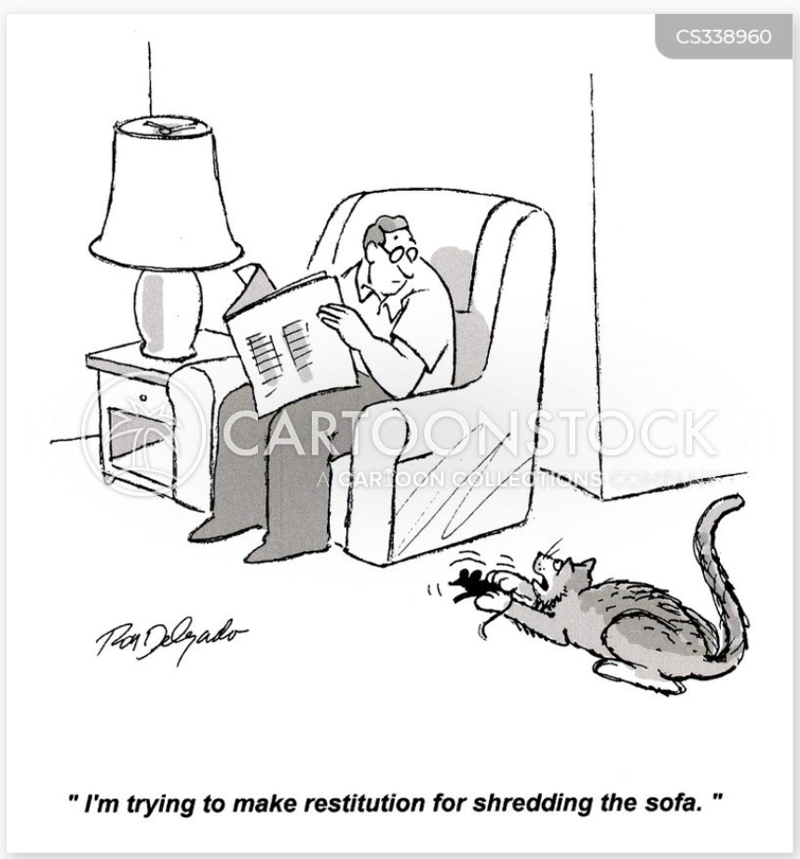
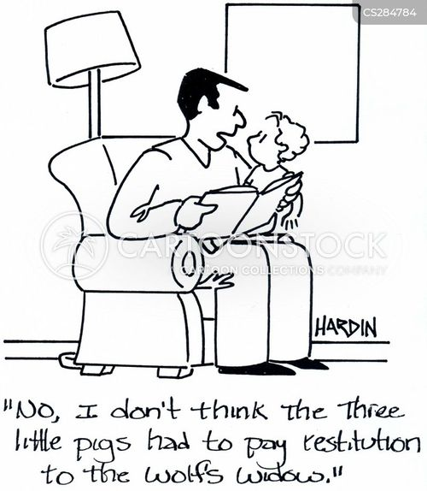
Sentencing and Restitution

Slide 25
Oral v. Written Conditions
Currier, 160 F.4th 656
Oral – “same conditions as previously imposed at last SR”; but now also included one re full time employment or job search; previous SR only required work regularly unless excused by PO; this was a discretionary condition, not a mandatory condition
Vacate and remand, but excised or amended?
*Today, we embrace and apply a bright-line rule: Any discretionary condition in a written judgment that conflicts with the sentence as orally pronounced must be excised on remand.
Baxter, 150 F.4th 386
SR revocation - written judgment stated “[a]ll previous conditions of supervision remain the same.” – but these were not orally pronounced (all about drug treatment)
All affirmed except for the DISCRETIONARY condition about ‘submission to search’; the others were mandatory
King, 155 F.4th 341
USSG 5G1.3b1 – presentence credit
71-month sentence “with credit for time already served awaiting this sentence,” and that the sentence would run concurrent to King's parole revocation sentences in two state criminal cases; further it did not want King “to spend any more time in jail other than what [it] just gave” him
written judgment stated only that the sentence is to run concurrent with the two state parole revocation sentences.
other confusing procedural parts, but overall – vacated and remanded for clarification re whether it would have imposed the same sentence regardless of how the pre-sentence detention was credited, or whether the district court intended some other result
Lezama-Ramirez, 173 F.4th 191
Conditions listed in the PSR provided notice of standard and special conditions, esp when no objection made - affirmed
However, at sentencing, judge orally VARIED pronouncement of two conditions – must be vacated
Mendoza, 170 F.4th 921
Restitution amount and home confinement condition left open for 90 days at gov request – gov never requested; after 90 days, written judgment included financial disclosure and credit approval conditions, only related to restitution
Vacated all of the contested conditions
*also, because government failed to request restitution hearing, no restitution was ever ordered and two conditions were not related
Quezada-Atayde, 148 F.4th 360
Special condition re reporting to ICE until deportation; included in PSR appendix but not read by court, but acknowledged by defense
Defense counsel did not object to PSR or at sentencing; plain error – none bc notice was there; affirmed
Notes:
General rule
3583d conditions do not need to be read
Any condition that is not required under 3583d must be read
Any conflict (not ambiguity) – oral trumps written; a greater burden on defendant = conflict
Diggles and Currier are best cases

Slide 26
Lucas, 134 F.4th 810
Appeal waiver in wire fraud re MVRA and VWPA; challenged restitution owed based on ‘sentence cannot exceed stat max’;
restitution orders under the VWPA are not subject to the same statutory limits as the MVRA, if a defendant agrees to allow the district court to determine restitution under the VWPA, he cannot appeal that order as exceeding the statutory maximum. And under the MVRA, a defendant may only challenge whether the district court had the authority to issue restitution in the first place; he may not challenge the district court's calculations.
Further, we have clarified that a defendant cannot challenge the methods used by a district court to conduct its restitution analysis at all so long as the district court performed some sort of analysis; a defendant may only challenge a restitution order if the district court failed to conduct the necessary analysis entirely.
*look at what restitution is ordered under – MVRA or VWPA
West, 137 F.4th 395
CP $6000 restitution; appeal waiver – allowed to appeal a sentence exceeding the “statutory maximum”; no Paroline analysis can violate SM
Paroline – restitution orders are proper “only to the extent the defendant's offense proximately caused a victim's losses
where no proximate-cause was conducted, there is no basis upon which the court can order any amount of restitution
En BANC denial – 138 F.4th 357 – dissents and concurrences – wanted rehearing to address appeal waiver
The panel decision holds that, in fact, appeal waivers mean nothing when the underlying decision was “illegal.” West, 99 F.4th at 780. With respect, that is deeply wrong. The whole point of an appeal waiver is that it prevents us from determining whether the district court erred. Saying appeal waivers matter only when we decide the district court got it right is like saying precedent matters only when we agree with it.
To sum up our precedent: Under Bond, an appeal waiver cannot be avoided by arguing that a sentence is “illegal” or “erroneous.” But if a restitution award is “erroneous,” then the appeal waiver is meaningless under Leal and Winchel. But under Alfred and Meredith, some appeals of “erroneous” restitution awards are nonetheless barred by appeal waivers, while under West still others are not. For anyone hoping to strike a plea deal under this cloud of uncertainty, for any judge hoping to accept plea deals under this cloud of uncertainty, and for any appellate panel hoping to know the extent of its post-plea-deal power under this cloud of uncertainty: Good luck.
Ulysses Rubalcava, 160 F.4th 664
CP production; restitution $55,000 – $10k in restitution (Paroline), $30k based on AVAA; had $450,000 injury money in a trust;
Restitution affirmed – Ulysess proximately caused injuries to his daughters – therapy and counseling bill estimates were sufficient
AVAA affirmed – court allowed to look at trust fund for financial purposes
Restitution
Notes:
***THESE CASES ARE THE MOST DIFFICULT – DIFFERENT RESTITUTION STATUTES APPLIED, many of which I don’t believe are applied in the NDMS
*really just look at the statute of restitution, Paroline analysis is mandatory if over $3000
West – this was a CP trafficking case – restitution is governed by 18 usc 2259, not 3663A; court erred by citing incorrect statute
Ulyssess – AVAA – Andy Child Pornography Assistance Act

Slide 27


Wake up!
We’re finally done!
This Photo by Unknown Author is licensed under CC BY-NC-ND

