Slide 1

The Fourth Amendment
What do the Supreme Court Justices think it is?

Slide 2
Amendment IV to the United States Constitution
The right of the people to be secure in their persons, houses, papers, and effects, against unreasonable searches and seizures, shall not be violated, and no Warrants shall issue, but upon probable cause, supported by Oath or affirmation, and particularly describing the place to be searched, and the persons or things to be seized.

Slide 3
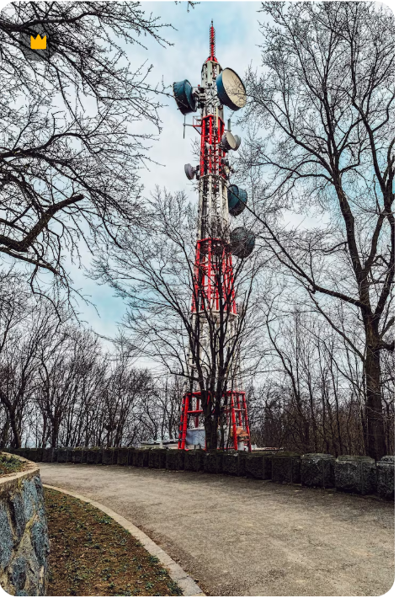
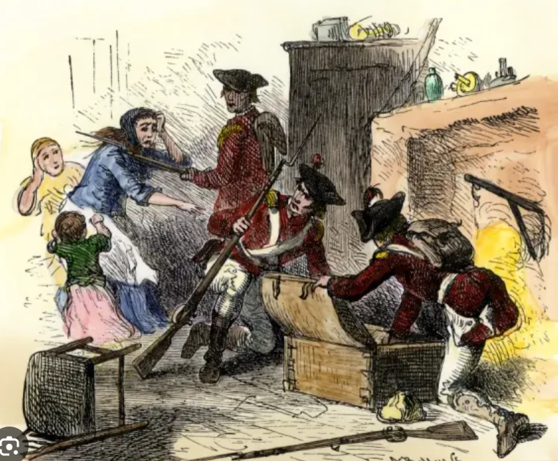
Notes:
The Founding generation crafted the Fourth Amendment as a “response to the reviled ‘general warrants' and ‘writs of assistance’ of the colonial era, which allowed British officers to rummage through homes in an unrestrained search for evidence of criminal activity.” Riley v. California, 573 U.S. ––––, ––––, 134 S.Ct. 2473, 2494, 189 L.Ed.2d 430 (2014).
Carpenter v. United States, 585 U.S. 296, 303, 138 S. Ct. 2206, 2213, 201 L. Ed. 2d 507 (2018)

Slide 4

“…a pervasive and insistent part of daily life”

Slide 5
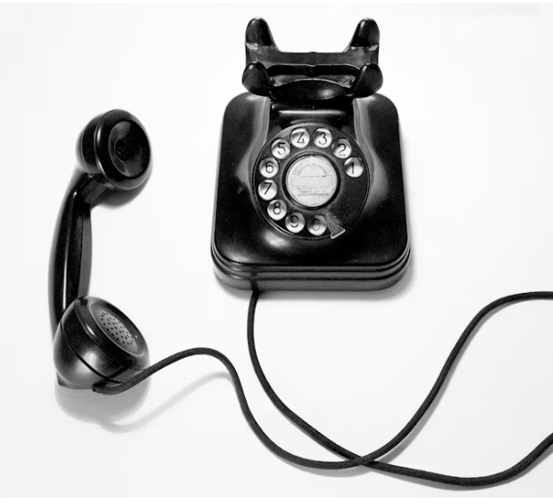

Are we really talking about a ‘phone.”

Slide 6
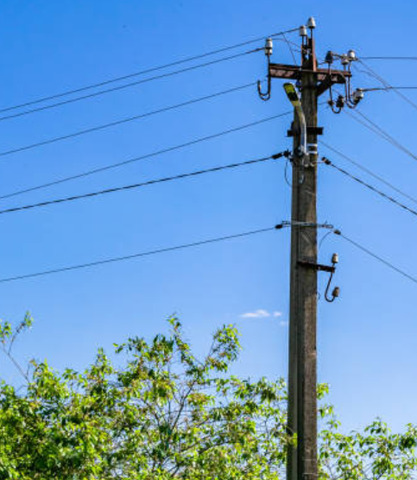
Olmstead v. United States, 277 U.S. 438, (1928) : Small wires were inserted along the ordinary telephone wires from the residences of four of the petitioners and those leading from the chief office. The insertions were made without trespass upon any property of the defendants. They were made in the basement of the large office building. The taps from house lines were made in the streets near the houses.

Slide 7
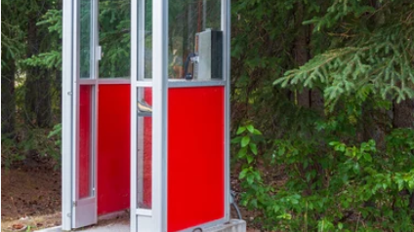
Katz
Fourth Amendment protects people not places.
Re- Examination of the “trespass” concept.
Reasonable expectation of privacy test.

Slide 8
Katz v. United States, 389 U.S. 347, 351 (1967)
“This effort to decide whether or not a given ‘area’, viewed in the abstract, is ‘constitutionally protected’ deflects attention from the problem . . . . For the Fourth Amendment protects people, not places.”

Slide 9
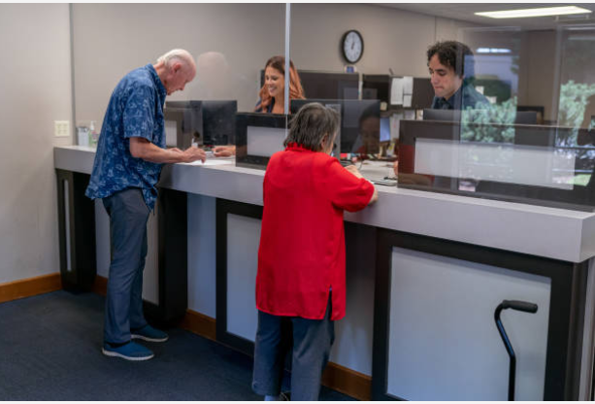
United States v. Miller, 425 U.S. 435 (1976)
No legitimate “expectation of privacy” in the contents of the original checks and deposit slips.
Notes:
But in Katz the Court also stressed that “(w)hat a person knowingly exposes to the public . . . is not a subject of Fourth Amendment protection.” 389 U.S., at 351, 88 S.Ct., at 511, 19 L.Ed.2d, at 582.
United States v. Miller, 425 U.S. 435, 442, 96 S. Ct. 1619, 1623, 48 L. Ed. 2d 71 (1976)

Slide 10
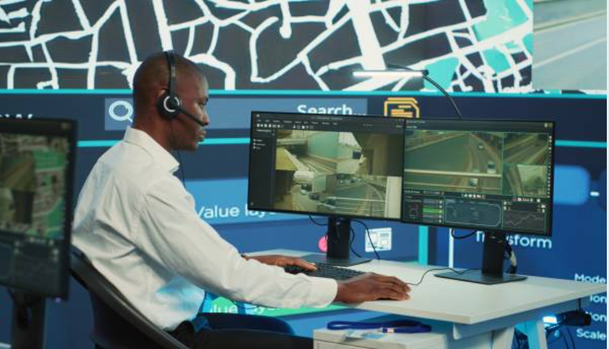
United States v. Knotts, 460 U.S. 276, 103 S.Ct. 1081, 75 L.Ed.2d 55 (1983)

Slide 11
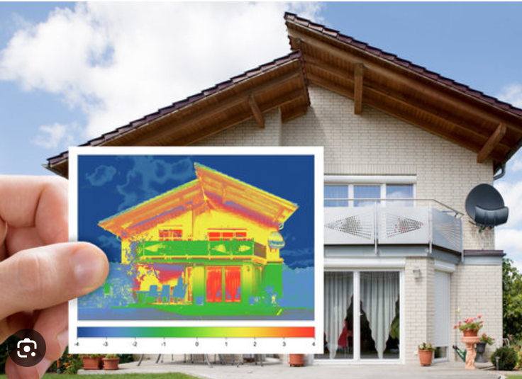
Kyllo v. United States, 533 U.S. 27, 34, 121 S.Ct. 2038, 150 L.Ed.2d 94 (2001): Use of a thermal imager to detect heat radiating from the side of the defendant's home was a search.

Slide 12
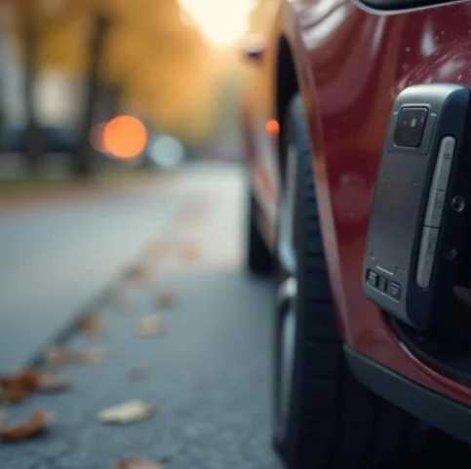
United States v. Jones, 565 U.S. 400 (2012)
Placing GPS device on car constituted a search in violation of the Fourth Amendment

Slide 13

Riley v. California, 573 U.S. 373 (2014)
“Search incident to arrest” exception could not justify post-arrest search of a cell phone.
Cell is almost a “feature of human anatomy,”

Slide 14

Knight v. State, 407 So.137 (Miss. 2025)
“Private search” exception.
Justice Ishee’s dissent: “risk of revelation” was inherent in Detective’s search of the cell phone.
“Virtual Certainty” requirement

Slide 15
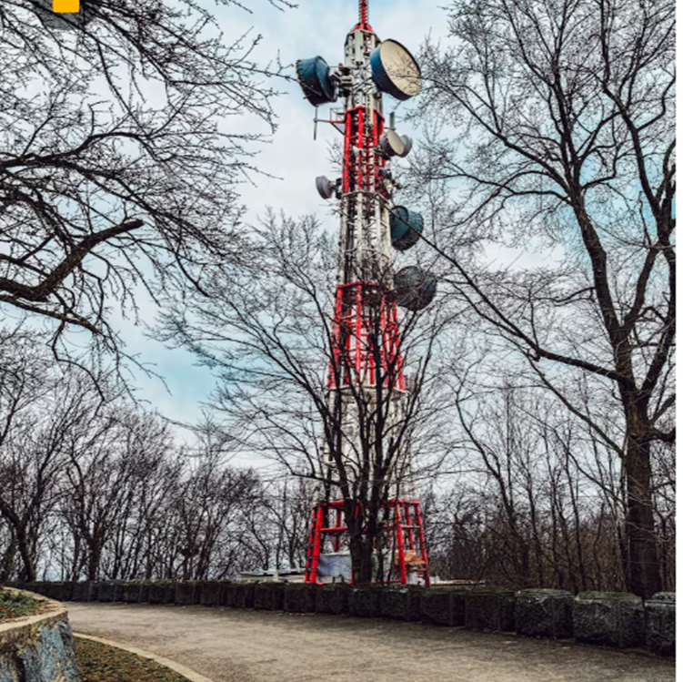
Carpenter v. United States, 585 U.S. 296 (2018) – Cell Site Location Information
CSLI likened to GPS monitoring considered in Jones
Detailed, encyclopedic, and effortlessly compiled
Rejected “voluntary exposure” argument - CSLI is not truly shared
“such a pervasive and insistent part of daily life.”
Notes:
Cell phone logs a cell-site record w/o any affirmative act of user
The court simply stated that it would not extend the holding in Smith and Miller to include CSLI, but also said that this holding “does not disturb the application of Smith and Miller.

Slide 16


Slide 17
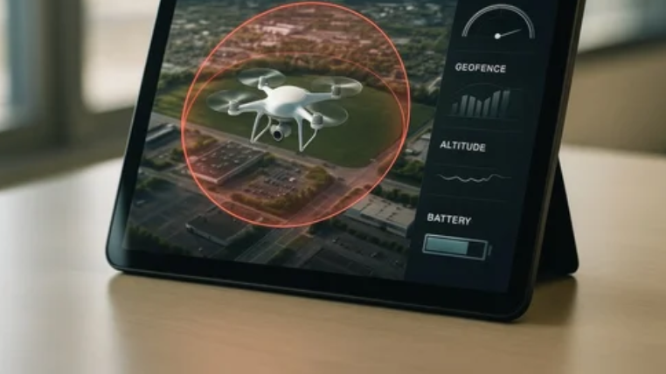
Geofence Warrants

Slide 18
United States v. Smith, 110 F.4th 817 (5th Cir. 2024)
Geofence warrant – 3 Step Process
592 Google Users included to identify suspects in a robbery
Fifth Circuit: “. . . the most alarming aspect of geofences is the potential for ‘permeating police surveillance.”
Rejected the “opt in” = voluntary disclosure
Good faith exception applied
Petition for cert. pending

Slide 19
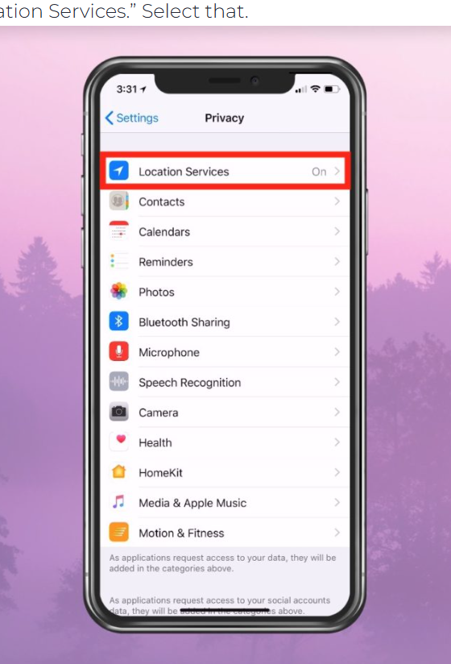
Voluntary Disclosure and “Opt – In” Function

Slide 20
Tower Dump/Tower Extraction Warrants
“Thus, while the Government's aim is to identify or rule out suspects in the crimes that took place at each location, it is asking the Court to give it access to information about every communication in the covered time and area made by every person, including more detailed location data (beyond the address serviced by a given tower) that the “sector” information will provide.” In re Four Applications for Search Warrants, No. 3:25-CR-38-CWR-ASH, 2025 WL 1792841, at *3 (S.D. Miss. June 27, 2025)
Notes:
In terms of the temporal scope of the Government's request, each warrant application seeks data for devices connecting to the towers serving the nine locations for a combined total of 220 minutes. So the Government wants the Court to require the four cellular providers to provide data for a total of 880 minutes—or more than 14 hours—for every device connecting to any of the towers serving those locations.

Slide 21

Using An Expert
Illustrate the significance of the intrusion
What could be done with the data
Address “voluntary disclosure”
Encyclopedic and effortlessly compiled

Slide 22
Challenging Other Forms of Surveillance as Fourth Amendment Searches
Automated License Plate Readers
Facial Recognition

Slide 23
United States v. Spurlock, 778 F. Supp. 3d 1136, 1141–42 (D. Nev. 2025)
(Referring to the defense expert): First, she demonstrated that, while Investigator Pelichowski does not appear to have done this in his investigation, from the tower dump records, she was able to determine roughly where the various phones listed in the data were and could plot them on a map if she wanted to. Second, she determined that after accounting for de-duplication the tower dump records contained records—again, including rough location information—for 1686 unique phones. Third, she clarified that the wireless company users whose phones showed up in the tower dump data did not opt in to sharing their location with their wireless provider, and indeed, could not opt out from appearing in the type of records received in response to warrant 20-SW-56.

