Slide 1
Navigating Crawford
Testimonial Hearsay and the Right to Confront

Slide 2

Justin T. Cook
Director, Indigent Appeals Division
Office of State Public Defender
(601) 576-4290
jcook@ospd.ms.gov

Slide 3
01
Hearsay
A Brief Word About Hearsay

Slide 4
Hearsay defined
Mississippi Rule of Evidence 801 provides the following relevant definitions:
Statement. “Statement” means a person’s oral assertion, written assertion, or nonverbal conduct, if the person intended it as an assertion.
Declarant. “Declarant” means the person who made the statement.
(c) Hearsay. “Hearsay” means a statement that:
(1) the declarant does not make while testifying at the current trial or hearing; and
(2) a party offers in evidence to prove the truth of the matter asserted in the statement.
801(d) outlines statements that are not hearsay.

Slide 5
02
Text
The Sixth Amendment to the United States Constitution and its State analogue.

Slide 6
Note:
Sixth Amendment analysis is not purely limited to Crawford. The are significant cases conerning the Sixth Amendment application to cross-examination.

Slide 7
The Sixth Amdedment:
“in all criminal prosecutions, the accused shall enjoy the right . . . To be confronted with the witnesses against him.”

Slide 8
Art. 3 Sec. 26:
“In all criminal prosecutions the accused shall have a right to be heard by himself or counsel, or both, to demand the nature and cause of the accusation, to be confronted by the witnesses against him . . . ”

Slide 9
03
History
Understanding the history of the right to confront informs our legal arguments.

Slide 10
Two Historical Basises
The Romans
Shakespeare
In Acts 25:16, the Roman Governor Festus, when discussing the proper treatment of his prisoner, Paul, stated: “It is not the manner of the Romans to deliver any man up to die before the accused has met his accusers face-to-face, and has been given a chance to defend himself against the charges.”
King Richard II sets this procedure for trial: “Then call them into our presence – face to face, and frowning from brow to brow, ourselves will hear the accuser and the accused freely speak . . .”
(Richard II, Act I, Scene I).

Slide 11
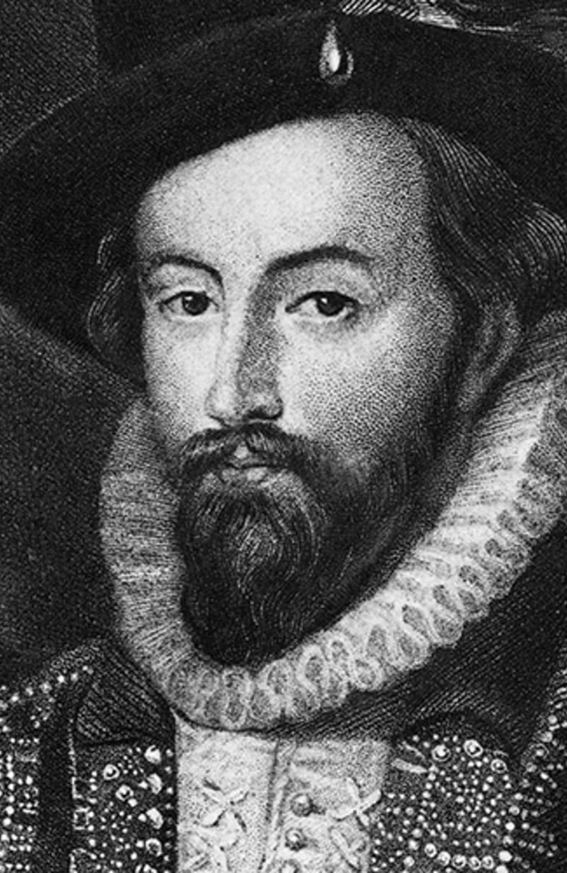
—Sir Walter Raleigh
“[Let] my accuser come face to face, and be deposed. Were the case but for a small copyhold you would have witnesses or good proof to lead the jury to verdict: and I am here for my life!”

Slide 12
Sir Walter Raleigh
Raleigh was put on trial in 1603:
Raleigh was arrested for his alleged involvement in the Main Plot against James 1, Queen Elizabeth’s successor, and imprisoned in the Tower of London.
At trial, where Raleigh represented himself, the Crown’s main evidence against him was a signed and sworn confession of Raleigh’s friend, Henry Brooke, 11th Baron Cobham.
Raleigh objected on hearsay grounds and repeatedly requested that Cobham be allowed to testify in Court. The tribunal refused.
Raleigh was ultimately convicted and sentenced to death.

Slide 13
Raleigh (cont.)
King James spared Raleigh’s life, but Raleigh remained imprisoned in the Tower of London until 1616.
After a big snafu in Guiana while Raleigh was searching for El Dorado, the Spanish King demanded King James reinstate Raleigh’s death sentence, which King James did.
Raleigh passed up numerous opportunities to escape, and was executed.
At his execution, Raleigh said, “At this hour, my argue comes upon me. I would not have my enemies think I quaked from fear.” After he was allwoed to see the axe that would be used to behead him, he joked, “This is a sharp medicien, but it is a Physiscian for all diseases and miseries.”

Slide 14
04
Legal History
Understanding the legal past allows us to better understand our law today.

Slide 15
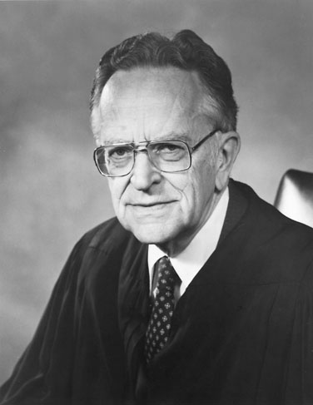
This nebulous language was the law for around 25 years:
Ohio v. Roberts, 448 U.S. 56 (1980).
The Old Rule
Out of court statements can be admissible if they bear an adequate “indicia of reliability,” even if a declarant is not available to testify in court.

Slide 16
Roberts
Roberts’s test was in line with Mancusi v. Stubbs, 408 U.S. 204 (1972), which held that where a State's witness is bona fide unavailable, the requirements of the Confrontation Clause are met when prior-recorded testimony of the witness is admitted if that prior testimony bears "indicia of reliability" that would afford "the trier of fact a satisfactory basis for evaluating the truth of the prior statement."

Slide 17
Roberts
Roberts was charged with forgery of a check and possession of stolen credit cards owned by Amy Isaacs. At the preliminary hearing, Roberts’ lawyer called Isaacs’s daughter as a witness to testify that she gave Roberts the checks and credit cards without telling him he did not have permission to use them. The daughter would not admit to doing so.
The daughter did not respond to subpoenas to appear at trial, and the State entered transcript of her earlier testimony into evidence, as allowed by Ohio Statute.

Slide 18
05
Crawford
A fundamental change

Slide 19
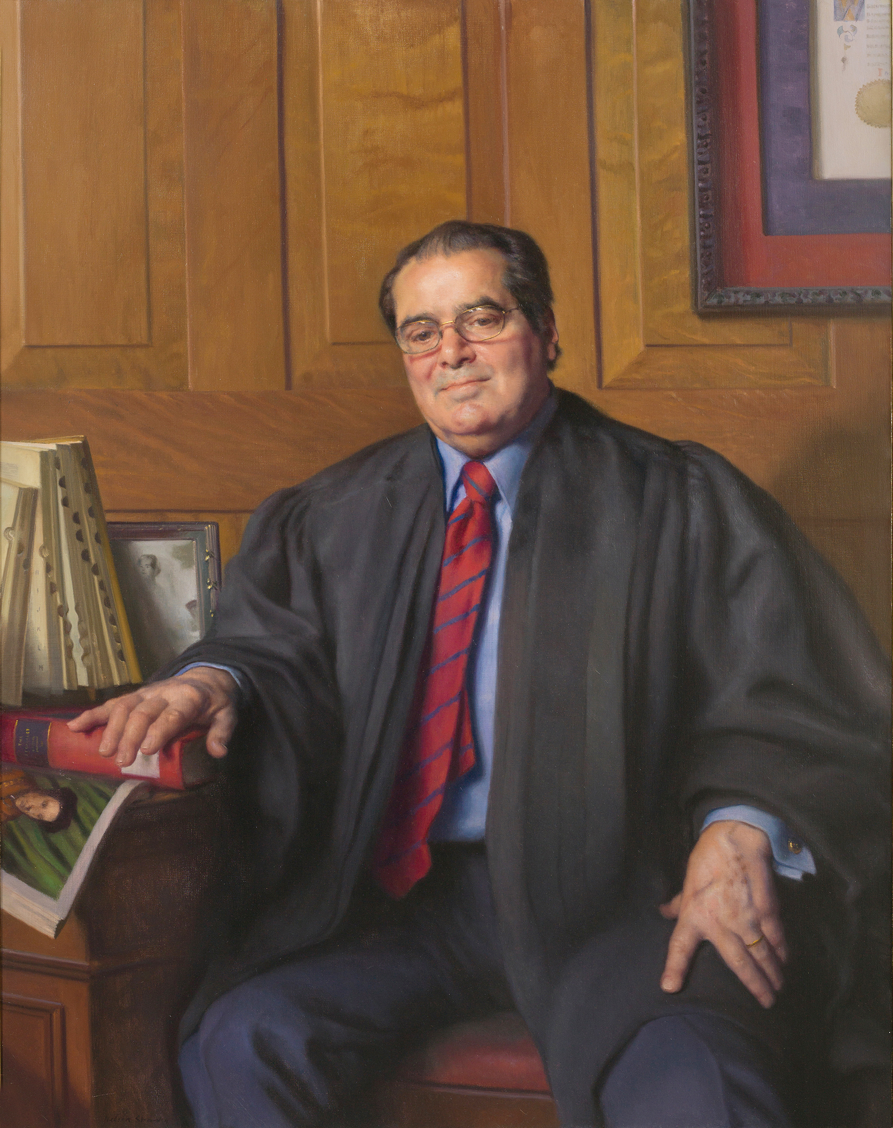
Established a clean and easy test for assessing confrontation clause claims:
Crawford v. Washington, 541 U.S. 36 (2004)
If a hearsay statement is testimonial in nature, and a defendant does not have the opportunity to cross-examine the declarant, the VI Amendment is violated.
So simple.

Slide 20
Crawford
Crawford and his wife confronted Lee, who was alleged to have raped Crawford’s wife.
In the fray, Lee was stabbed. Crawford and his wife were questioned separately. Crawford told police that he did not know whether Lee had a weapon. Crawford’s wife, on the other hand, told police that Lee was unarmed.
Crawford’s wife could not be compelled to testify because of Washington’s spousal privilege laws. Washington’s privilege law did not extend to out of court statements admissible under a hearsay exception.
The trial court allowed the State to admit Crawford’s wife’s statements, over defense counsel’s objection on Sixth Amendment grounds.
The prosecution relied heavily on the statement in its closing argument, and Crawford was ultimately convicted.

Slide 21
Crawford
The Washington Court of Appeals reversed Crawford’s conviction applying a particularly laborious (9 factors!) analysis under Ohio v. Roberts.
The Washington Supreme Court reinstated the conviction, concluding that the statement was reliable under Roberts.
SCOTUS, with Justice Scalia writing, abandoned the Roberts test, and instead created a new test.
***
If a statement is testimonial in nature, and the defendant does not have the opportunity to cross-examine that declarant, the Confrontation Clause of the VI Amendment is violated.
***

Slide 22
The Crawford Test
Testimonial?
Cross?
But!
Is the hearsay statement testimonial? If no, no analysis necessary. If yes, move on to step 2.
Declarant must tesitfy, or must be unavailable and previous subject to cross-examination.
Unless a defendant forfeited or waived the right to confront.

Slide 23
So, what is “testimonial?”
The Crawford Court deliberately never defined testimonial.
Crawford’s progeny would further develop what statements are testimonial in nature, for better or for worse.

Slide 24
06
Subsequent Caselaw

Slide 25
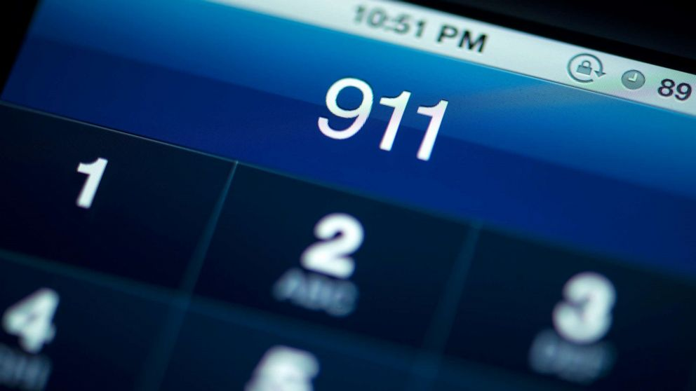
Concerns statements given to 911
Davis v. Washington, 547 U.S. 813 (2006).
“Statements are not testimonial when made in the course of police interrogation under circumstances objectively indicating that the primary purpose of the interrogation is to enable police assistance to meet an ongoing emergency.”

Slide 26
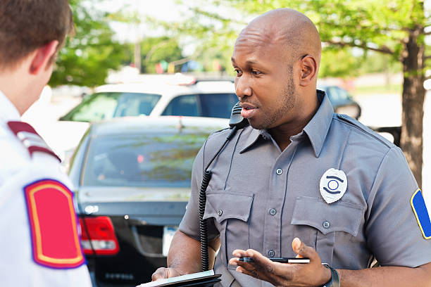
Companion case to Davis
Hammon v. Indiana, 547 U.S. 813 (2006).
Makes a distinction between emergencies and cases where emergencies have ended.

Slide 27
Hammon
Trial court allowed for the admission of on-the-scene questioning after the victim said things were “fine” as well as the victim’s handwritten affidavit.
Court found that there was no emergency in progress. The sole purpose of the “interrogation” by law enforcement was to investigate a past crime. The victim was separated from defendant and protected by police.
Statements by victim were testimonial: “They are testimonial when the circumstances objectively indicate that there is no such ongoing emergency, and that the primary purpose of the interrogation is to establish or prove past events potentially relevant to later criminal prosecution.”

Slide 28
Hammon
Statements made, even at the crime scene, where the emergency has stopped and that describe a past crime, and that involve interrogation by the police resulting in accusatory statements made by a calm declarant will be testimonial under Hammon.
But see Michigan v. Bryant.

Slide 29
Davis/Hammon Analysis
Govt.?
LEO?
Purpose?
Government invovled in creating the testimony or taking a formalized statement? If no, analysis is complete - It’s not testimonial. If yes, step 2!
Was there interrofation by law enforcement? If no, standard Crawford analysis. If yes…
If done to resolve an ongoing emergency, the statemnts are non-testimonial. If done to obtains facts of past crimes, perform standard Crawford analysis.

Slide 30
Bryant
(It gets complicated)

Slide 31
Michgican v. Bryant (2011).
Declarant, during the course of police interrogation, indicated that Bryant was the person who shot him. Declarant subsequently died.
Question presented:
“Are injuries of wounded victims concerning the perpetrator non-testimonial if they objectively indicate that the purpose of the interrogation is to enable police assistance to meet an ongoing emergency, and, thus, not afforded heightened protection under Crawford v. Washington?”

Slide 32
Bryant
Majority opinion by Justice Sotomayor: The Court held that the identification and description of the shooter and the location of the shooting were:
“not testimonial statements because they had a ‘primary purpose . . . To enable police assistance to meet an ongoing emergency.’ Therefore, their admission at Bryant’s trial did not violate the Confrontation clause.”

Slide 33
Bryant
Justice Scalia, not having it, dissented:
Criticized the majority for distorting “our confrontation clause jurisprudence and leav[ing] it in shambles. Instead of clarifying the law, the court makes itself the obfuscator of last resort.”
The majority “creates an expansive exception to the confrontation clause for violent crimes.”

Slide 34

Certificates of analysis
Melendez-Diaz v. Mass., 557 U.S. 305 (2009).
During drug prosecution, the State submitted “certificates of analysis,” affidavits showing results of drug tests.

Slide 35
Melendez-Diaz
The Court explicitly rejected the State’s argument that the neutral and reliable nature of forensic chemical testing would exclude the Confrontation requirement. Why? That’s a return to Roberts.
  “Forensic evidence is not uniquely immune from the risk of manipulation.”
The Court further rejected the State’s argument that the forensic affidavits met the business records exception to the hearsay rule .
  The Court essentially held that most business records will escape Sixth Amendment scrutiny not because they meet the exception to the hearsay rule, but because they are non-testimonial in nature.

Slide 36
Melendez-Diaz
Affidavits fall within “core class of testimonial statements.” Their admission, accordingly, violates the Confrontation Clause.
The Court distinguished the Compulsory Process Clause and the Confrontation Clause.
  Even though M-D had the opportunity to call the analyst at his option, this was no substitute for the protections of the Confrontation Clause.
  This would shift the burden of producing an adverse witnesses to the defense.

Slide 37
Melendez-Diaz
The Court rejected the State’s argument that a finding for M-D would place a substantial burden on the Courts – “the sky [would] not fall.”
SCOTUS, with Justice Scalia writing emphasized that the opinion in Melendez –Diaz was nothing more than a continuation of Crawford.
Virginia v. Briscoe had the same facts as Melendez-Diaz, but was seen as a test to see how Justice Sotomayor was going to decide. Two weeks after oral argument, the court issued a per curiam opinion. Anticlimactic.

Slide 38

Bullcoming v. New Mexico, 564 U.S. 647 (2011).
Can a blood-alcohol test admitted without the actual testimony of the person who prepared the results violate the Sixth Amendment Confrontation Clause?

Slide 39
Bullcoming
Bullcoming was sentenced to two years in prison for a felony aggravated DWI/DUI. The State introduced a blood alcohol test that was taken from Bullcoming under a search warrant issued. Bullcoming argued that the laboratory report of his blood draw results was testimonial evidence subject to the Confrontation Clause.
Supervisor testified to the content of the report – not the actual person who performed the test. Supervisor did not witness the test either.
In applying Melendez-Diaz, the New Mexico Supreme Court held that the blood alcohol report was testimonial evidence but was admissible even though the forensic analyst who performed the test did not testify.

Slide 40
Bullcoming
“The Confrontation Clause does not permit the prosecution to introduce a forensic laboratory report containing a testimonial certification, made in order to prove a fact at a criminal trial, though through the in-court testimony of an analyst who did not sign the certification or personally perform or observe the performance of the test reported in the certification.”

Slide 41
Ohio v. Clark, 576 U.S. 237 (2015).

Slide 42
Clark
A teacher at a preschool noticed a student with facial injuries. When that teacher asked the child, the child told the teacher that his mother’s boyfriend, Darius Clark, caused them. The teacher forwarded her concerns to a child-abuse hotline, which resulted in arrest and charges.
Prior to trial, the child was deemed incompetent to testify. The trial court, however, refused to exclude his out-of-court identification of Clark.
The Supreme Court of Ohio reversed the lower court and held that because state law required the teacher to report suspected abuse, the teacher was acting as an agent for law enforcement. Therefore, the child’s out-of-court statements could only be admitted if the primary purpose of the teacher’s questions was to address an ongoing emergency. Because the child was not in immediate danger of further injury, the admission of the statements was error.

Slide 43
Clark
SCOTUS held that the child’s statements to his teacher were non-testimonial, because the totality of the circumstances indicated that the primary purpose of the conversation was not to create an out-of-court substitute for trial testimony.
There was an ongoing emergency because the child, who had visible injuries could have been released into the hands of his abuser.
Moreover, a very young child who does not understand the details of the criminal justice system is unlikely to be speaking for the purpose of creating evidence.

Slide 44
Clark
The Court further held that a mandatory reporting statute does not convert a conversation between a concerned teacher and a student into a law enforcement mission aimed primarily at gathering evidence for a prosecution.

Slide 45
Smith v. Arizona, 609 U.S. 779 (2024)
Does the Confrontation Clause of the Sixth Amendment permit the prosecution in a criminal trial to present testimony by a substitute expert conveying the testimonial statements of a nontestifying forensic analyst?

Slide 46
Smith
Smith was charged with multiple felonies related to drug possession. At trial, a forensic scientist testified that the seized substances were illegal drugs.
However, this scientist merely relied on testing conducted by another scientist who did not testify. This is a classic case of surrogate testimony that we see in Mississippi quite often.
Holding: When an expert conveys an absent lab analyst’s statements in support of the expert’s opinion, and the statements provide that support only if true, then the statements come into evidence for their truth, and therefore implicate the Confrontation Clause.

Slide 47
Smith
In this case, the expert’s testimony relied entirely on accepting the non-testifying analyst’s statements as true. His opinions were predicated on accepting as true what the analyst reported about her lab work.
Allowing such a practice would undermine the court’s previous decisions in Bullcoming and Melendez-Diaz.
The Court remanded for a determination of whether the statements were testimonial by looking at each statement’s “primary purpose.”

Slide 48
07
Forfeiture

Slide 49
Giles v. Calif., 554 U.S. 353 (2008)
Giles shot and killed his ex-girlfriend. Prosecutors sought to introduce statements his ex-girlfriend made to police officers responding to a domestic-violence report three weeks prior to the shooting.
Over objection, trial court admitted the statements under a provision of California Law. (Crawford had yet to be decided during trial).
Crawford was handed down while appear was pending. State appellate courts affirmed conviction because Crawford recognized the doctrine of forfeiture by wrongdoing.

Slide 50
Giles
The United States Supreme Court did not agree, concluding that, in essence, a defendant who kills or intimidates a witness does not forfeit his right to confront that witness unless that defendant killed or intimidated that witness with the intent or purpose to prevent that witness from testifying.

Slide 51
08
Mississippi Caselaw
The good and the bad.

Slide 52
Mississippi Cases - a quick look.
Smith v. State, 986 So. 2d 290 (Miss. 2008) – codefendant’s out of court statement that implicated defendant violated Crawford.
Conners v. State, 92. So. 3d 676 (Miss. 2012) – crime lab reports admitted through a detective were testimonial and violated Crawford.
Corbin v. State, 74 So. 3d 333 (Miss. 2011) – a deceased victim’s interview with police violated Crawford.
Buchanan v. State, 316 So. 3d 619 (Miss. 2021) – Giles’ forfeiture by wrongdoing analysis followed by MSSC.

Slide 53
Mississippi cases (cont.)
Matthies v. State, 85 So. 3d 872 (Miss. Ct. App. 2011) – Intoxilyzer calibration records were non-testimonial.
Williams v. State, 970 So. 2d 727 (Miss. Ct. App. 2007) – CAC interview was testimonial hearsay.
Montson v. State, 318 So. 3d 1133 (Miss. Ct. App. 2020) – victim’s testimonial affidavit regarding prior domestic violence charges against defendant violated Crawford.
Bufford v. State, 191 So. 3d 755 (Miss. Ct. App. 2015) – victim’s statements made to detective at hospital were testimonial.

Slide 54
Mississippi cases (cont.)
Grim v. State, 102 So. 3d 1073 (Miss. 2012) – Technical review by laboratory supervisor is not prohibited surrogate testimony.
  “We hold that a supervisor, reviewer, or other analyst involved may testify in place of the primary analyst where that person was ‘actively involved in the production of the report and had intimate knowledge of analyses even though [he or] she did not perform the tests firsthand”

Slide 55
Mississippi cases (cont.)
Matthies v. State, 85 So. 3d 872 (Miss. Ct. App. 2011) – Intoxilyzer calibration records were non-testimonial.
Williams v. State, 970 So. 2d 727 (Miss. Ct. App. 2007) – CAC interview was testimonial hearsay.
Montson v. State, 318 So. 3d 1133 (Miss. Ct. App. 2020) – victim’s testimonial affidavit regarding prior domestic violence charges against defendant violated Crawford.
Bufford v. State, 191 So. 3d 755 (Miss. Ct. App. 2015) – victim’s statements made to detective at hospital were testimonial.

Slide 56
Mississippi cases (cont.)
Littleton v. State, 390 So. 3d 516 (Miss. Ct. App. 2024) – admission of a recorded statement of a witness who did not testify violated Crawford.

