Slide 1
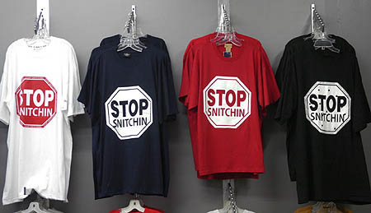
CJA Panel Attorney Training2019
CROSS EXAMINING THE SNITCH
LISA M. WAYNE
DENVER/BOULDER/SAN FRANCISCO
@LMONET/LMONET20@ME.COM
This Photo by Unknown Author is licensed under CC BY-NC

Slide 2
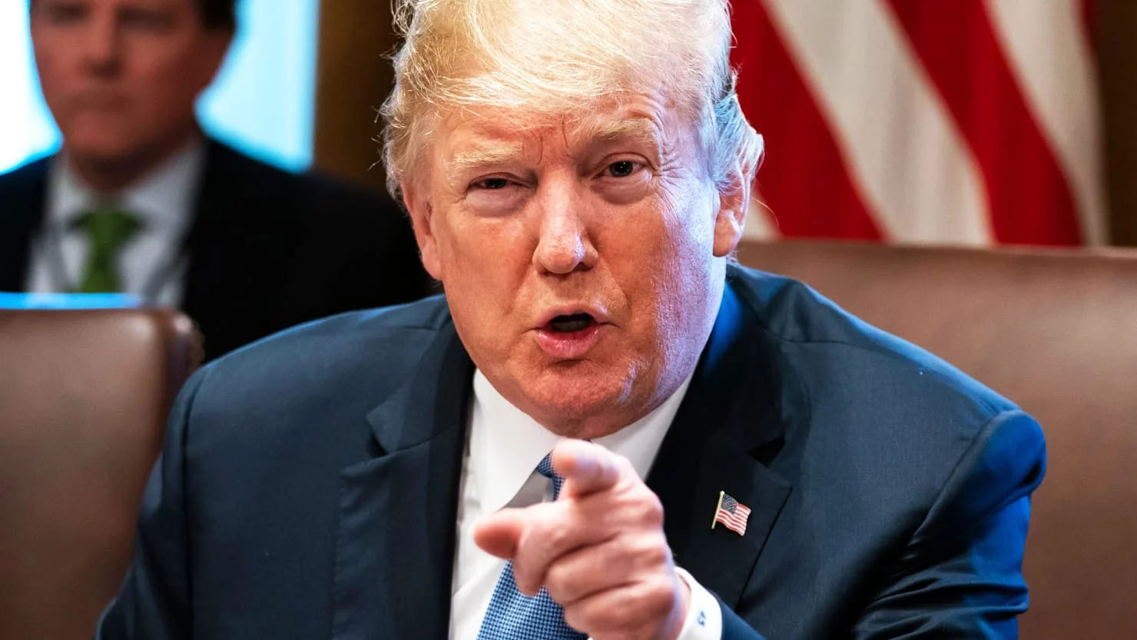
President Trump has attacked "flipping" and cooperation, saying that "it should almost be illegal.” Reacting to his lawyer Michael Cohen's plea deal, Trump says “I know all about flipping. For 30, 40 years I have been watching flippers. . . . I have seen it many times. I have had many friends involved in this stuff.”
This Photo by Unknown Author is licensed under CC BY

Slide 3
SNITCHING OR TEKASHI 69 (SIX NINING)
There are many reasons to agree that snitching "should almost be illegal." It leads to wrongful convictions; it tolerates the crimes committed by informants; it coerces the most vulnerable and rewards the most culpable. It promotes government secrecy, rule breaking, and sometimes corruption

Slide 4
In court, one of the few times that public bias favors the defense is when we cross-examine an informant.
Prior to the implementation of the Federal Sentencing Guidelines in 1987, only the disloyal sold out their family and friends to shave time off of their sentences. However, with the advent of mandatory minimum sentences and draconian guidelines, defendants often race each other to the government's door to see who can squeal first. So, while we have come to accept informants as permanent fixtures in the criminal "justice" system, we need to remember that most of the general public still treats them with disdain.

Slide 5
DON’T LET THE GOVERNMENT SUGARCOAT
CALL IT WHAT IT IS
Terms like informant, snitch, rat, Judas, deal, plea- bargain, reward, and payoff, are now cooperating witness, confidential source, C.I., plea agreement, 5k1 motion, cooperation agreement, and information & expense payment

Slide 6

THE ATTORNEY GENERAL'S GUIDELINES REGARDING THE USE OF CONFIDENTIAL INFORMANTS
7. "Cooperating Defendant Witness" - any individual who: a. meets the definition of a CI; has agreed to testify in a proceeding as a result of having provided information to the JLEA; and b. (i) is a defendant or potential witness who has a written agreement with a FPO, pursuant to which the individual has an expectation of future judicial or prosecutive consideration or assistance as a result of having provided information to the JLEA, or c. (ii) is a potential witness who has had a FPO concur in all material aspects of his or her use by the JLEA.

Slide 7

YOU HAVE A LOT TO WORK WITH AN INFORMANT USUALLY COMES WITH LOTS OF BAGGAGE.

Slide 8
BACKGROUND INFORMATION
TAKE ADVANTAGE OF BELONGING TO AN ESTABLISHED NETWORK OF DEFENDERS
FEDERAL DEFENDER OFFICES
CRIMINAL DEFENSE BAR LISTSERVES
NACDL

Slide 9
COURTHOUSE RESEARCH
CRIMINAL RECORDS
PENDING CASES
CLOSED CASES
PROBATION/SUPERVISED RELEASE VIOLATIONS
PRETRIAL BOND INFORMATION IF AVAILABLE
BOND FORFEITURES

Slide 10
DIVORCE RECORDS
MARRIAGE LICENSE RECORDS
IDENTITY OF FORMER SPOUSE AND POSSIBLE WITNESSES FOR FORMER SPOUSE
GROUNDS FOR DIVORCE
FINANCIAL INFORMATION
FAILURE TO PAY CHILD SUPPOT

Slide 11
CIVIL SUITS
FRAUD
BREACH OF CONTRACT
PERSONAL INJURY
DEBT COLLECTION

Slide 12
PROPERTY RECORDS
PROPERTY PURCHASED
PROPERTY SOLD
MORTGAGE COMPANIES
LOAN APPLICATION INFORMATION

Slide 13
SOCIAL MEDIA SEARCH

Slide 14

INTERNET SEARCHES AND SEARCH ENGINES

Slide 15

GOVERNMENT MANUAL
DEA AND FBI AGENT’S MANUALS (AVAILABLE THROUGH NACDL OR FOIA REQUEST
GET THE POLICY REGARDING DOCUMENTATION OF INFORMANTS
GUIDELINES FOR HANDING INFORMANTS
SUITABILITY REQUIREMENTS
This Photo by Unknown Author is licensed under CC BY-SA

Slide 16
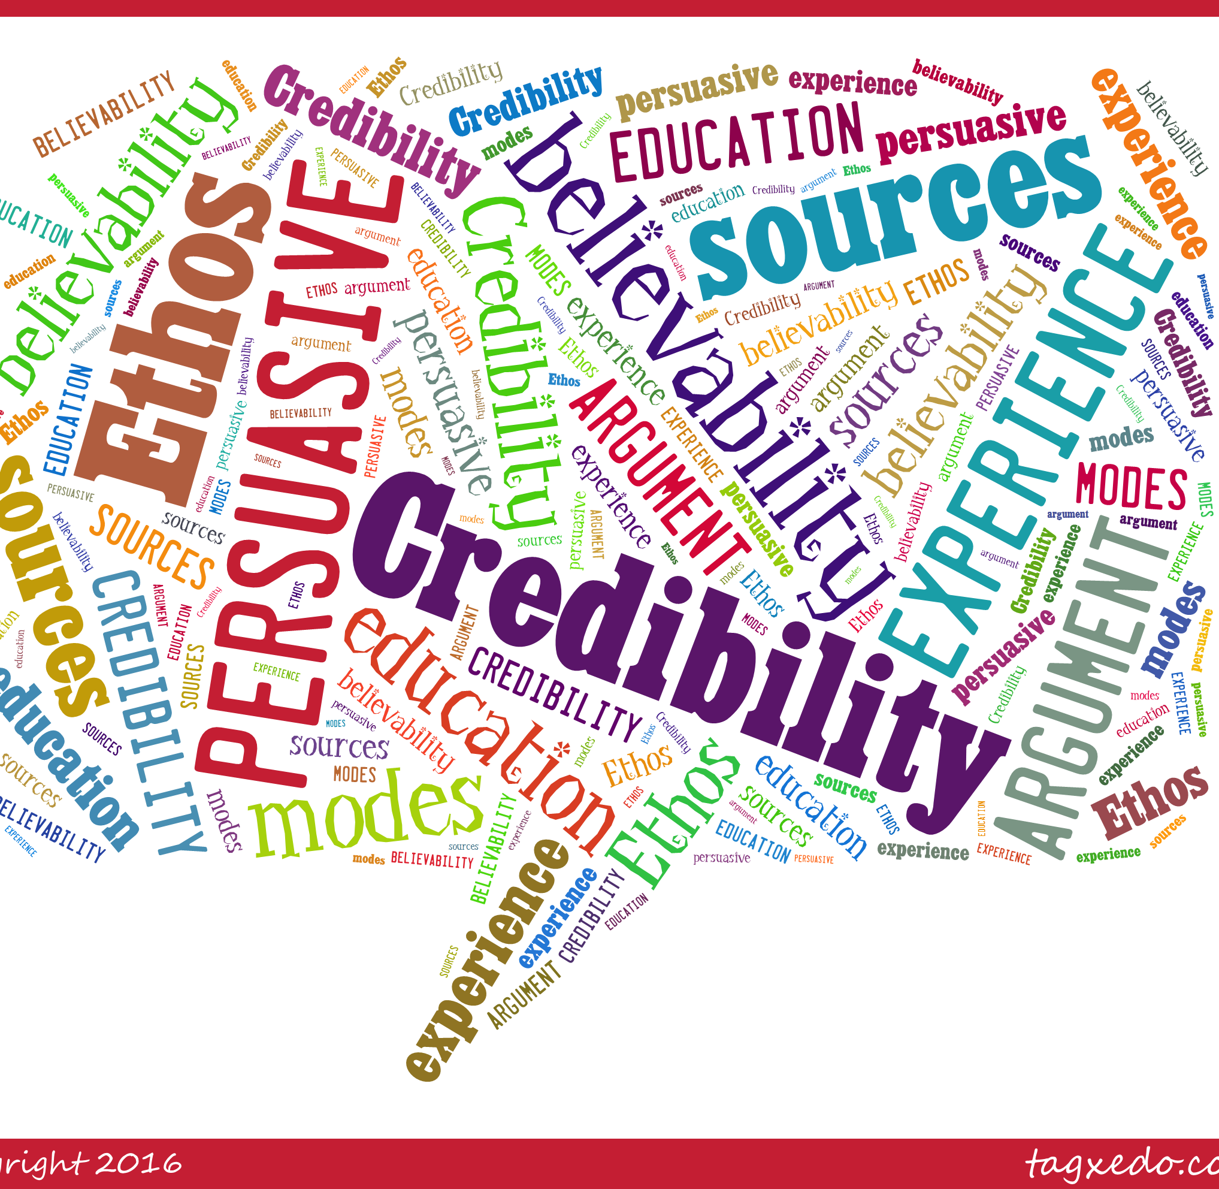
CHAPTERS FOR CROSS-EXAMINATION
This Photo by Unknown Author is licensed under CC BY

Slide 17
IMPEACHMENT
PRIOR ACTS OF DISHONESTY
USE OF ALIASES, FALSE DATES OF BIRTH, INCORRECT SOCIAL
PURPOSE-AVOID DETECTION, PERPETRATE A FRAUD
Your Background research
Loan applications
Employment
Prior Arrest-lying to law enforcement
Lies on bond applications

Slide 18
BENEFITS TO THE INFORMANT
FINANCIAL REWARDS
SENTENCE REDUCTIONS 5K.1 “I DON’T KNOW WHAT I WILL RECEIVE, I WAS JUST TOLD TO TELL THE TRUTH”
RULE 35 MOTION-ONLY THE GOVERNMENT CAN FILE WITHIN A YEAR OF SENTENCE
IMMUNITY
FORFEITURE

Slide 19
Theory of the Witness to your Defense
NOT TO BELIEVED AT ALL
SOME OF IT IS BELIEVABLE BUT TO THE EXTENT IT INCRIMINATES YOUR CLIENT IT IS NOT TO BE BELIEVED
BELIEVE THEM BUT SEE HOW DIRTY THE GOVERNMENT IS HERE AND IT COMPROMISES PROOF BEYOND A REASONABLE DOUBT

Slide 20

WINNING
This Photo by Unknown Author is licensed under CC BY

