Slide 1
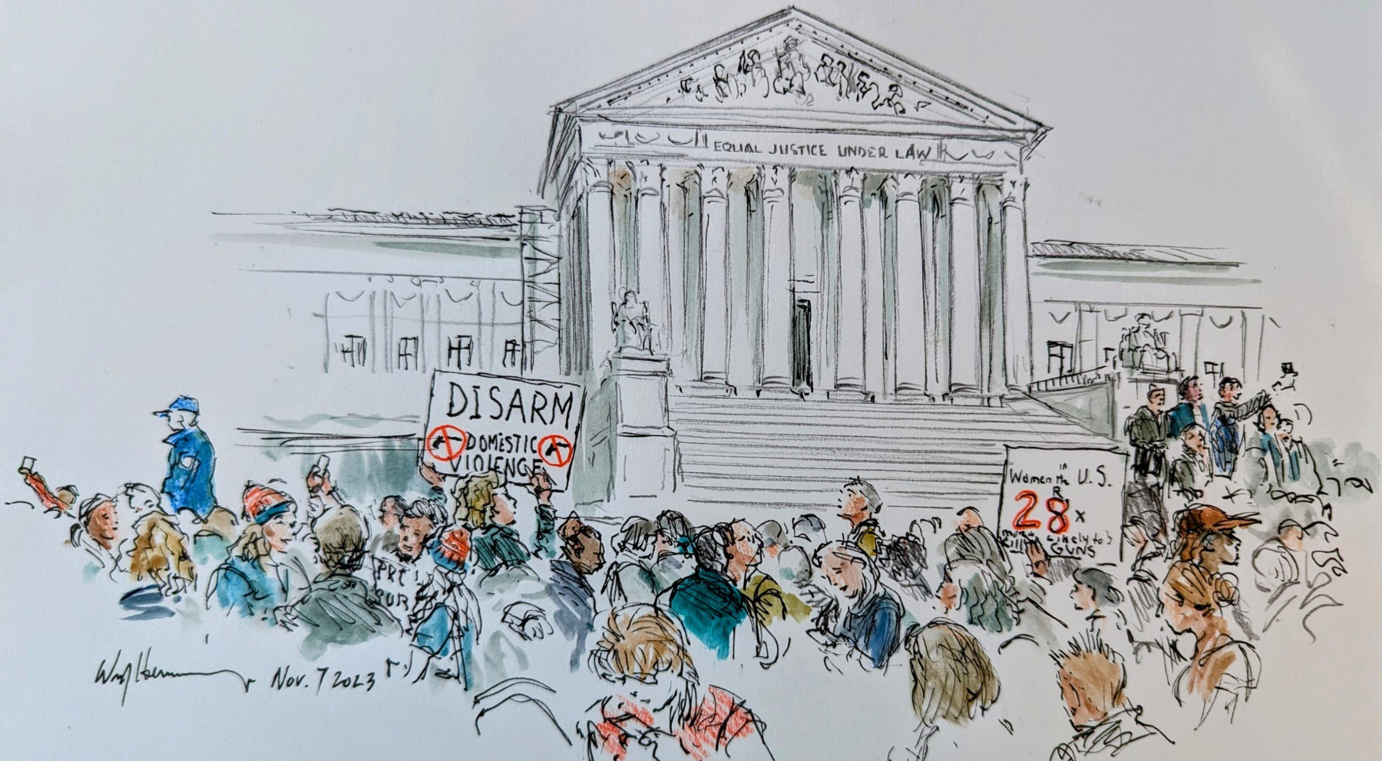

Slide 2
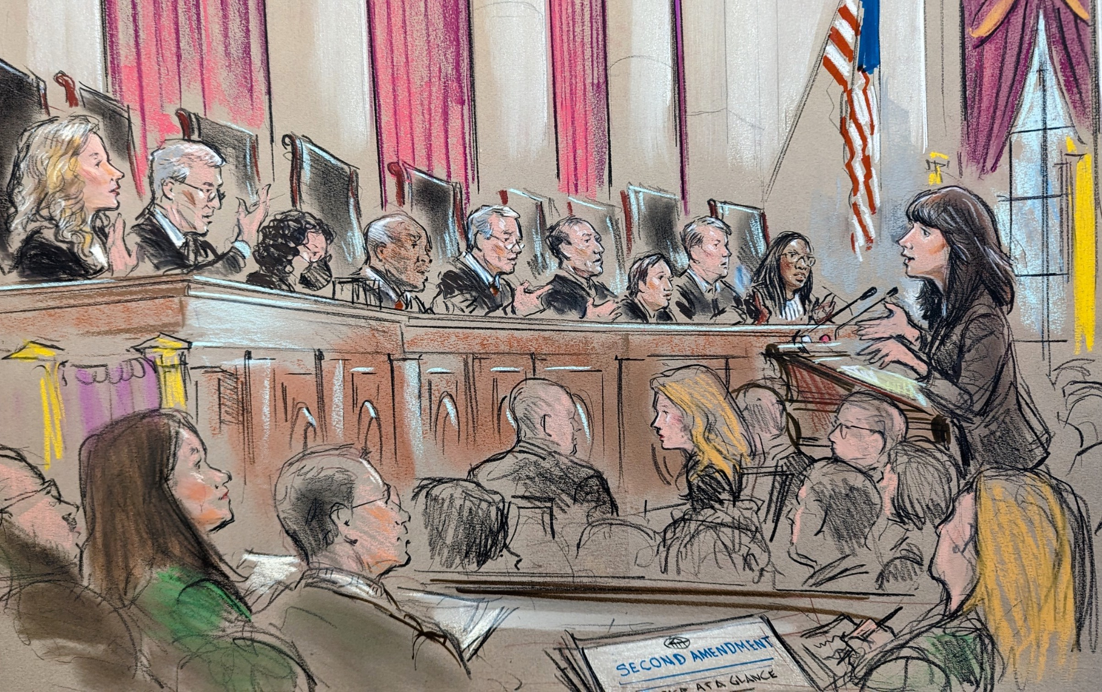
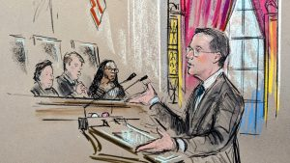

Slide 3
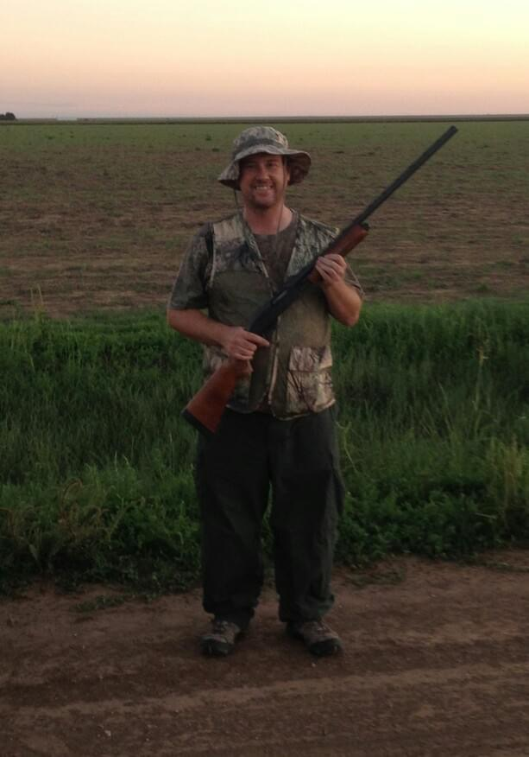

Slide 4
Heller’s House Rule
Bruen’s Breakthrough
Rahimi’s Retreat
__________’s _________

Slide 5
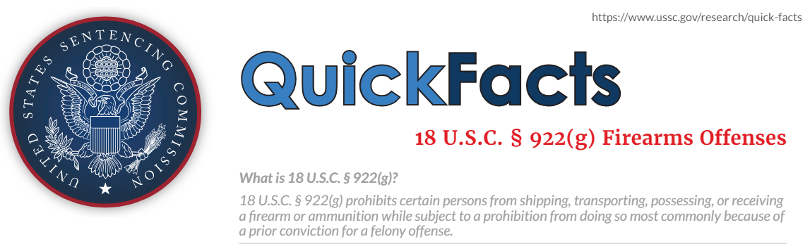
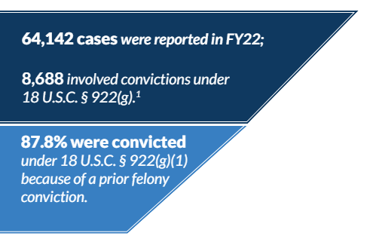
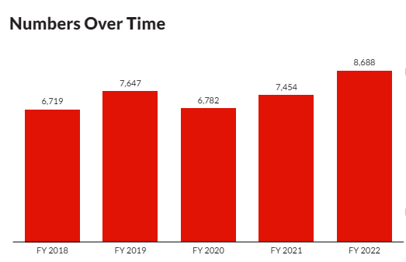

Slide 6
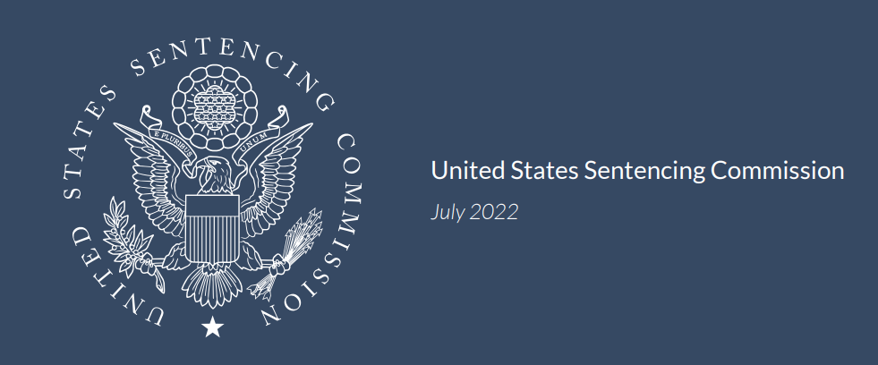
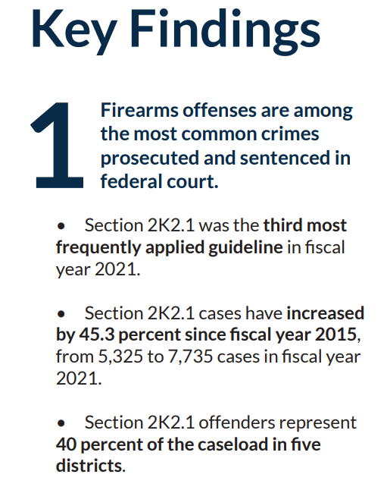
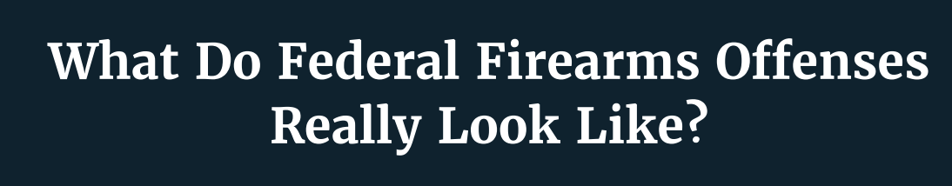
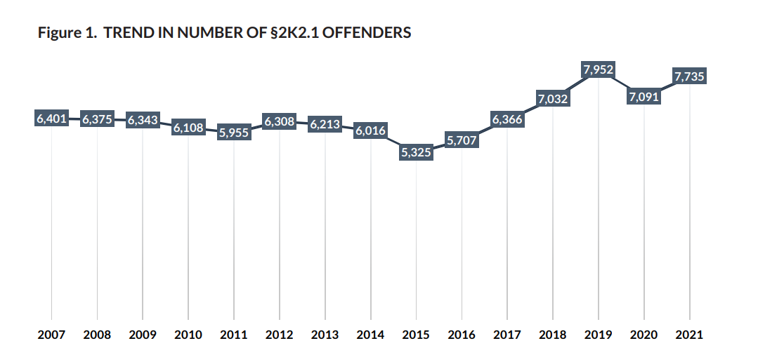

Slide 7
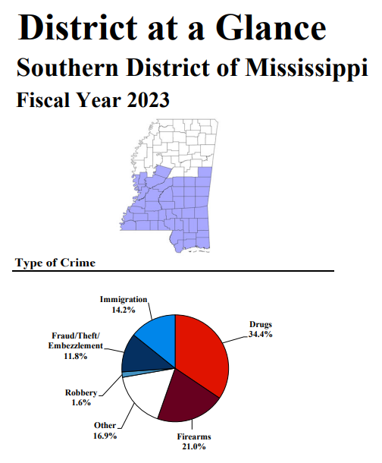

Slide 8
“Felon” in Possession
18 U.S.C. § 922(g)(1):
“It shall be unlawful for any person—(1) who has been convicted in any court of, a crime punishable by imprisonment for a term exceeding one year . . .”
to
  ship or transport in interstate or foreign commerce,
  or possess in or affecting commerce,
any firearm or ammunition;
or
  to receive any firearm or ammunition which has been shipped or transported in interstate or foreign commerce.

Slide 9
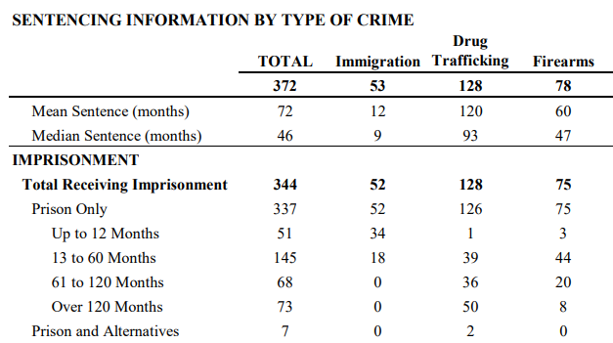
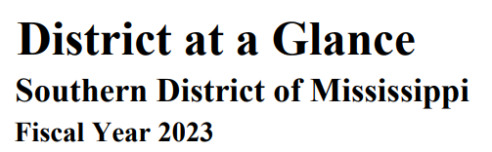
Punishable by up to 15 years in prison
If ACCA enhancement applies, 15 years to life in prison

Slide 10
Other Prohibited Person Categories
18 U.S.C. § 922…
(g)(3): “who is an unlawful user of or addicted to any controlled substance…”
(g)(5): “who, being an alien—
  is illegally or unlawfully in the United States; or
  (B) except as provided in subsection (y)(2), has been admitted to the United States under a nonimmigrant …”

Slide 11
(g)(8): “who is subject to a court order that—
(A) was issued after a hearing of which such person received actual notice, and at which such person had an opportunity to participate;
(B) restrains such person from harassing, stalking, or threatening an intimate partner of such person or child of such intimate partner or person, or engaging in other conduct that would place an intimate partner in reasonable fear of bodily injury to the partner or child; and
(C)
  includes a finding that such person represents a credible threat to the physical safety of such intimate partner or child; or
  by its terms explicitly prohibits the use, attempted use, or threatened use of physical force against such intimate partner or child that would reasonably be expected to cause bodily injury…”

Slide 12
Sentenced in FY2018-FY2022
18 USC § 922(g)(1): 32,402
18 USC § 922(g)(8): 167
(including 19 who were also convicted under (g)(1))
Source: USSC Individual Datafiles

Slide 13
“A well regulated Militia, being necessary to the security of a free State, the right of the people to keep and bear Arms, shall not be infringed.”

Slide 14
Heller’s House Rule
Bruen’s Breakthrough
Rahimi’s Retreat
__________’s _________

Slide 15


Slide 16


Slide 17



Slide 18
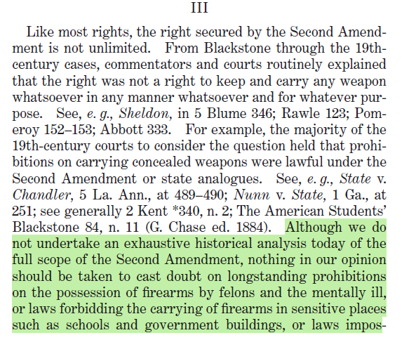
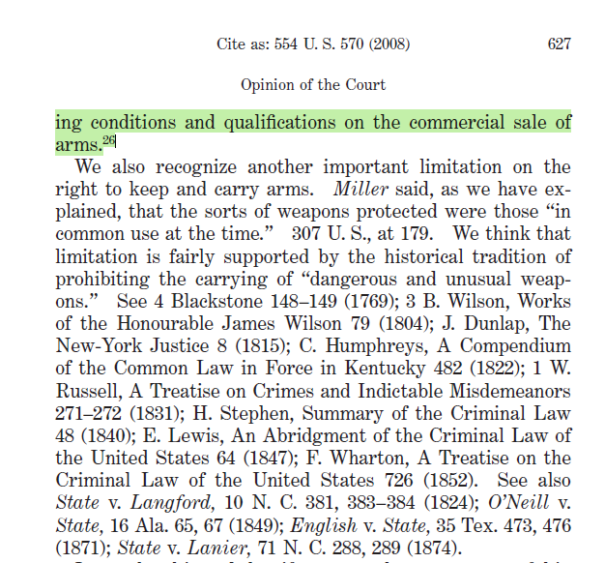


Slide 19
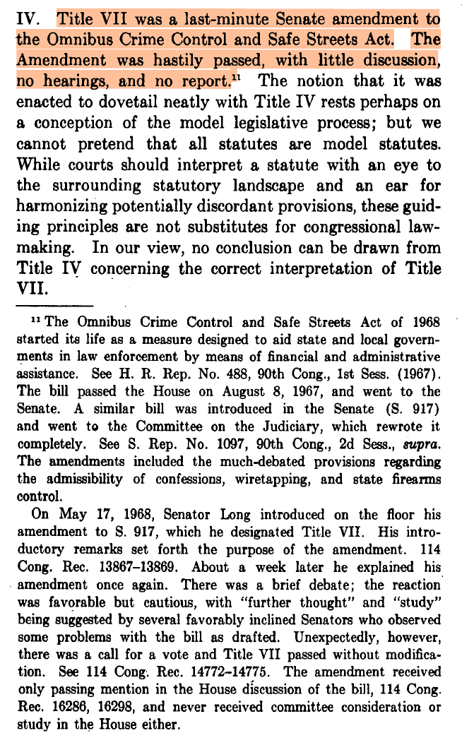

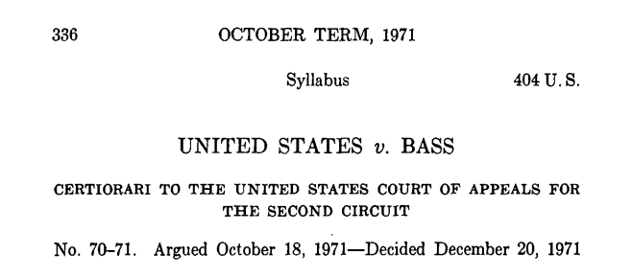

Slide 20
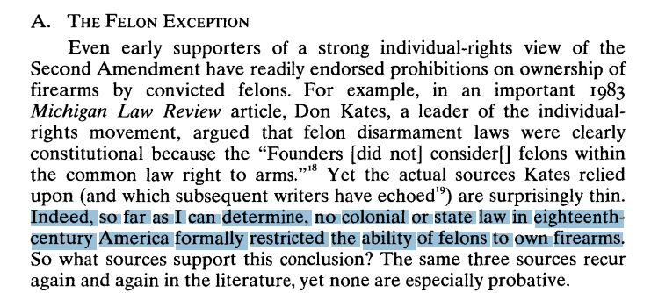

Slide 21
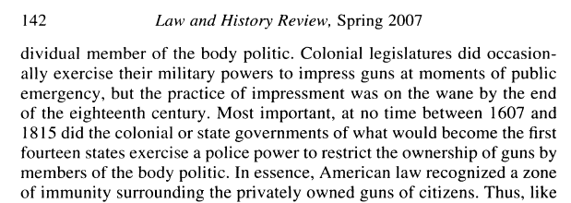
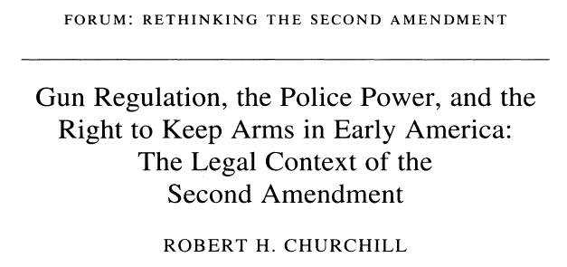


Slide 22
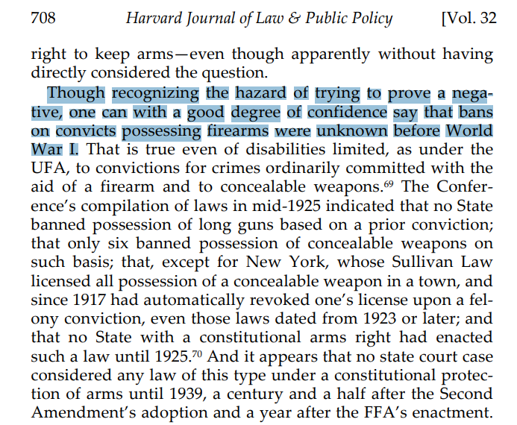
C. Kevin Marshall, Why Can’t Martha Stewart Have a Gun?, 32 Harv. J. L. & Pub. Pol’y (2009)

Slide 23
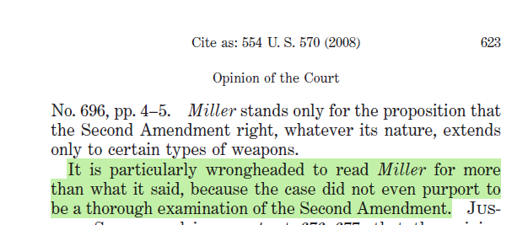

Slide 25
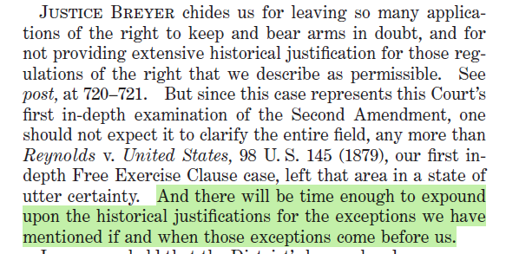


Slide 26




Slide 27

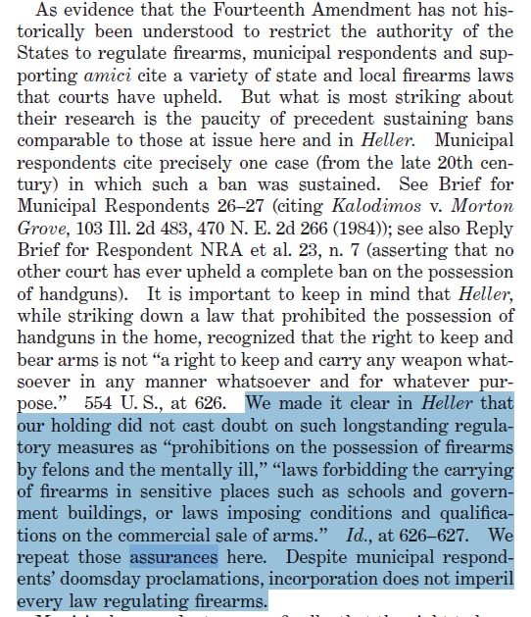


Slide 28
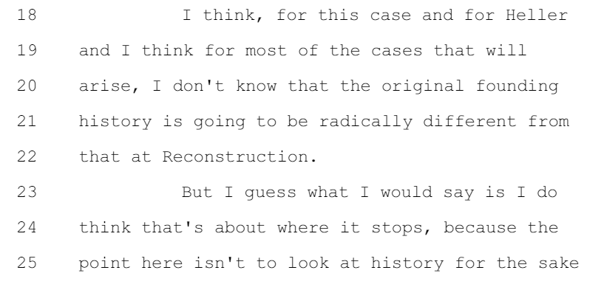
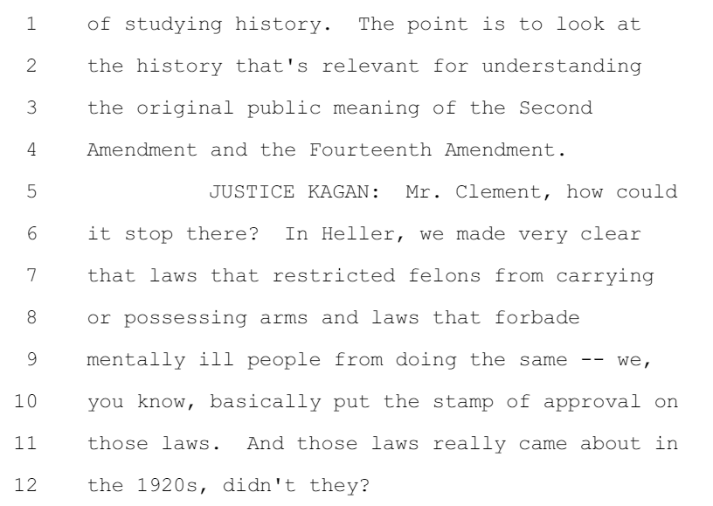


Slide 29
Heller’s House Rule
Bruen’s Breakthrough
Rahimi’s Retreat
__________’s _________

Slide 30

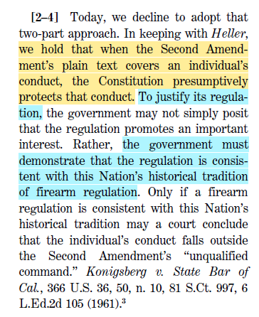

Bruen propounded a new framework:

Slide 31
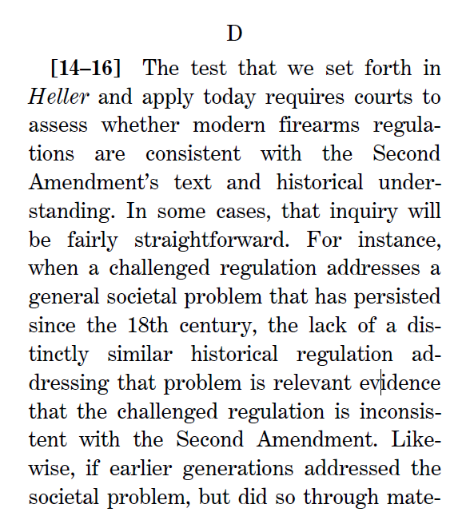
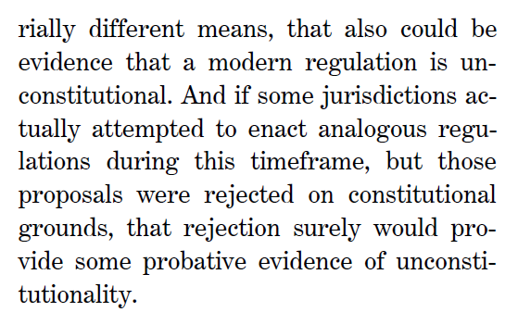


Slide 32
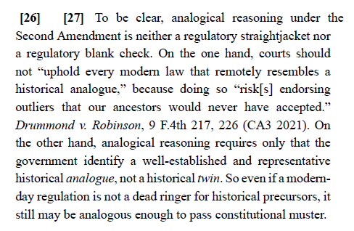

Slide 33

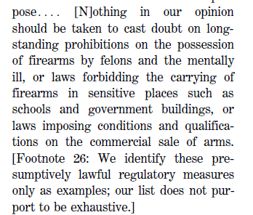
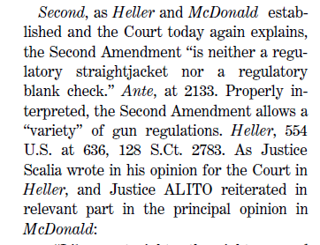


Slide 34
Heller’s House Rule
Bruen’s Breakthrough
Rahimi’s Retreat
__________’s _________

Slide 35
On the basis of Bruen, the Fifth Circuit held that 18 U.S.C. § 922(g)(8) – criminalizing possession of a firearm by a person under a domestic-violence restraining order – was unconstitutional under the Second Amendment (United States v. Rahimi, 61 F.4th 443 (5th Cir. 2023))
SCOTUS granted the Government’s petition for cert.

Slide 36
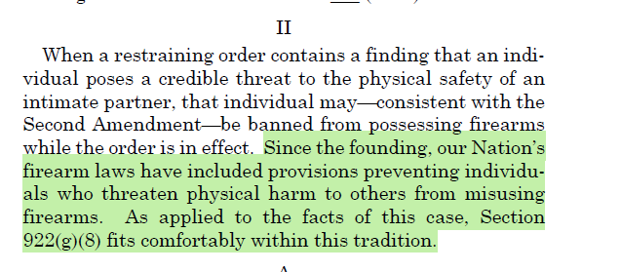

Slide 37
18 U.S.C. § 922(g)(8) is constitutional “as applied to the facts of Rahimi’s own case” because “the Second Amendment permits the disarmament of individuals who pose a credible threat to the physical safety of others.”
A modern firearm regulation must “comport with the principles underlying the Second Amendment,” but need not be a “dead ringer” for a Founding-era law. Founding-era surety and “going armed” laws “targeted the misuse of firearms,” and § 922(g)(8) “fits neatly within the tradition the surety and going armed laws represent.”

Slide 38
Heller’s House Rule
Bruen’s Breakthrough
Rahimi’s Retreat
__________’s _________

Slide 39
Post-Rahimi Cases in the Fifth Circuit
United States v. Connelly, 117 F.4th 269 (5th Cir. 2024)—sustains as-applied Amendment challenge to 18 U.S.C. § 922(g)(3) (possession by unlawful user of a controlled substance): Connelly, a marijuana user, was not actively intoxicated.
United States v. Medina-Cantu, 113 F.4th 537 (5th Cir. 2024)—rejects Second Amendment challenge to 18 U.S.C. § 922(g)(5)(A) (possession by an alien illegally in the United States), because non-citizens unlawfully present are not among “the people.”

Slide 40
18 U.S.C. § 922(g)(1)–Felon in Possession
United States v. (Ronnie) Diaz, 116 F.4th 458 (5th Cir. 2024):
  Rejects facial challenge
  Rejects as-applied challenge “specifically targeted to Diaz’s circumstances,” but others may succeed:
    “Felon” status alone is not enough
    Ignores Diaz’s misdemeanor convictions; “felony” convictions for conduct that was noncriminal at the Founding (including felon-in-possession); and felonious misconduct during the instant offense
    Diaz’s felony conviction for vehicle theft was similar enough to horse- stealing, which was a capital offense at the Founding.
  En Banc Reh’g denied (Oct. 25, 2024)

Slide 41
“As-Applied” Challenges to § 922(g)(1) in the Sixth Circuit:
United States v. Williams, 113 F.4th 637 (6th Cir. 2024): Rejects challenge where Defendant had felony convictions for “aggravated robbery”; “attempted murder,” and felon-in-possession. Standard is “Dangerousness.”
    “When evaluating a defendant’s dangerousness, a court may consider a defendant’s entire criminal record—not just the specific felony underlying his § 922(g)(1) conviction.”
    Convictions that show dangerousness: crimes against the person; crimes like drug-trafficking and burglary that indicate “significant threat of danger”
    Convictions that do not: “crimes like mail fraud . . . or making false statements”; “[b]ut we trust district courts will have no trouble concluding that many of these crimes don't make a person dangerous”

Slide 42
“As-Applied” Challenges to § 922(g)(1) in the Sixth Circuit:
United States v. Goins, 118 F.4th 794 (6th Cir. 2024): Applying Williams “dangerousness” standard, rejects as-applied challenge where Defendant had convictions for DUI (x4), Driving w/ suspended license, possession of controlled substance, public intoxication, criminal mischief; condition of probation banning guns
  Three reasons Defendant lost:
    (1) Goins violated probation by possessing gun;
    (2) “Goins was under a relatively short probation sentence for a dangerous crime”; and
    (3) “his repeated actions demonstrated a likelihood of future dangerous conduct.”

Slide 43
“As-Applied” Challenges to § 922(g)(1) in the Eighth Circuit:
United States v. Jackson, 110 F.4th 1120 (8th Cir. 2024): Rejects as-applied challenge for Defendant convicted of “sale of a controlled substance” (2x)
  “Given these assurances by the Supreme Court, and the history that supports them, we conclude that there is no need for felony-by-felony litigation regarding the constitutionality of § 922(g)(1).”
  En Banc Reh’g denied (Nov. 5, 2024)

Slide 44
“As-Applied” Challenges to § 922(g)(1) in the Third Circuit:
United States v. Moore, 111 F.4th 266 (3d Cir. 2024): Rejects as-applied challenge because Defendant was on federal supervised release for prior § 922(g)(1) conviction, which followed a federal cocaine-distribution conviction: “tradition of disarming” people under a criminal justice sentence
  Arguably “defense of property” (Defendant confronted, and fired at, people breaking into car)
Range v. Attorney General, No. 21-2835 (3d Cir.): Civil Challenge
  Before Rahimi, the En Banc court sustained an as-applied challenge where plaintiff had been convicted of non-felony false statement punishable by five years’ incarceration
  SCOTUS vacated, remanded after Rahimi
  En Banc Court heard re-argument; awaiting decision

Slide 45
Unsettled and Uncomfortable
Practical Questions
At what point in the process may you raise an “as-applied” challenge? At what point in the process must you raise an “as-applied” challenge?
  Pretrial motion to dismiss?
  Change-of-Plea Hearing?
  Objections to Report and Recommendation on Guilty Plea?
  Sentencing?
Who has the burden of proof or persuasion? Do Rules of Evidence apply?
Does this challenge survive an unconditional guilty plea?

Slide 46
Heller’s House Rule
Bruen’s Breakthrough
Rahimi’s Retreat
__________’s _________
BONUS ROUND

Slide 47
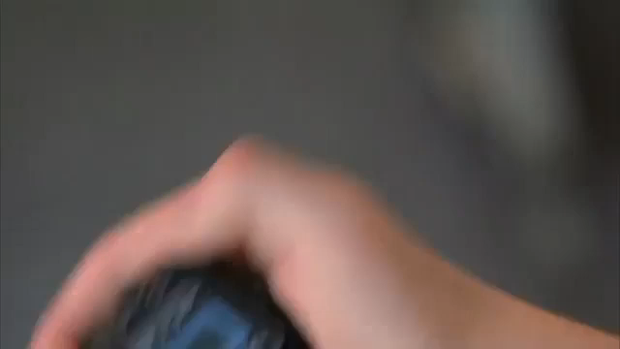

Slide 48
“A well regulated Militia, being necessary to the security of a free State, the right of the people to keep and bear Arms, shall not be infringed.”

Slide 49
“A well regulated Militia, being necessary to the security of a free State, the right of the people to keep and bear Arms, shall not be infringed.”

Slide 50
“A well regulated Militia, being necessary to the security of a free State, the right of the people to keep and bear Arms, shall not be infringed.”

Slide 51
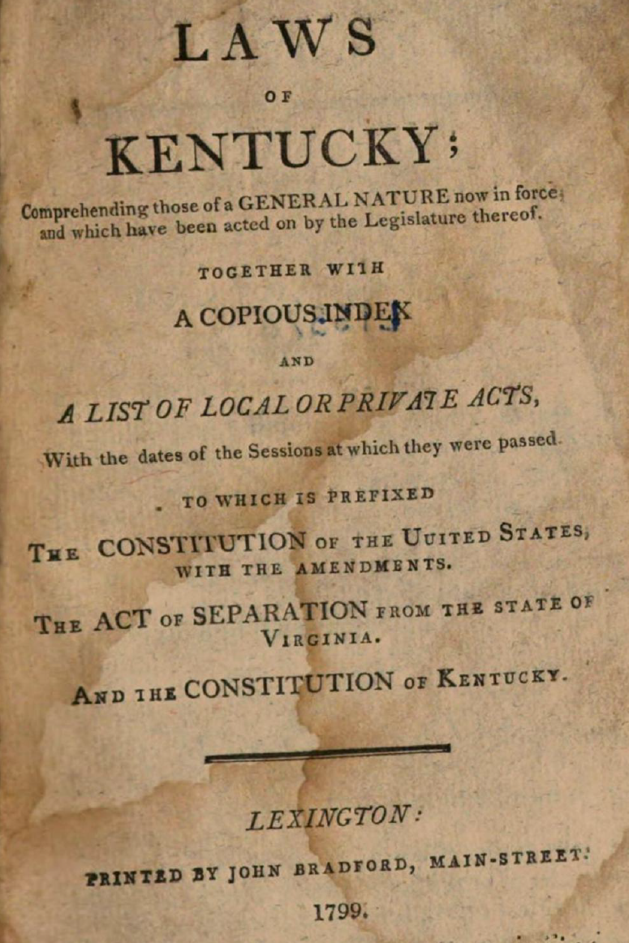
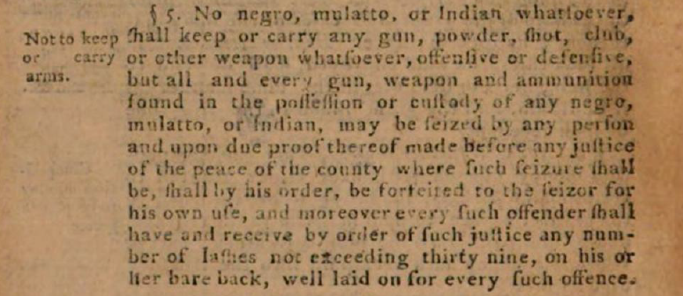

Slide 52
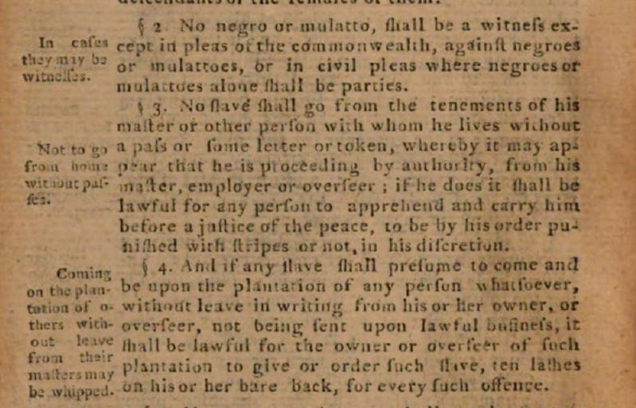

Slide 53
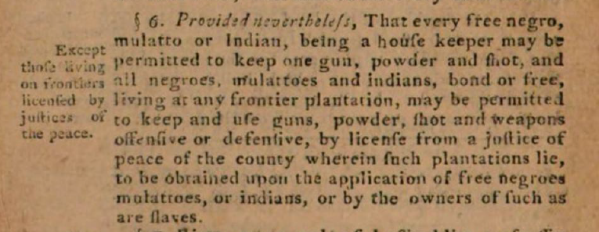

Slide 54
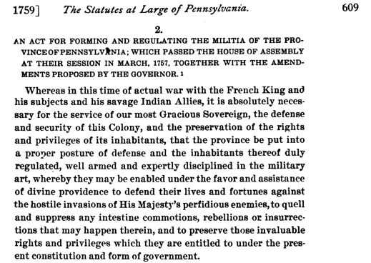

Slide 55
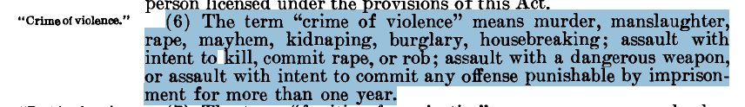
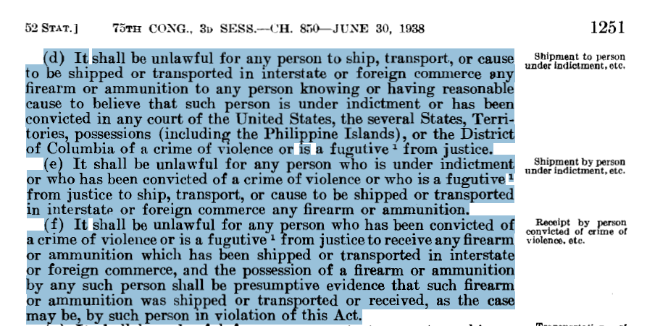
* This presumption was declared unconstitutional in Tot v. United States, 319 U.S. 463, 464, 472 (1943).

Slide 56
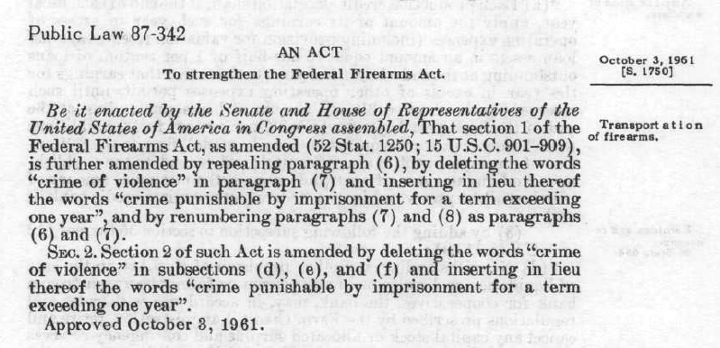

Slide 57
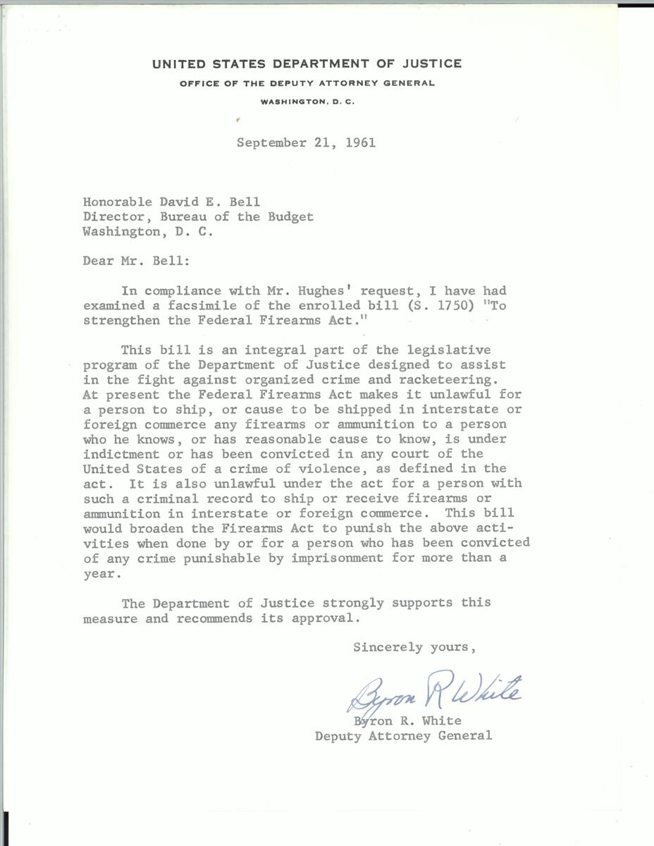

Slide 58
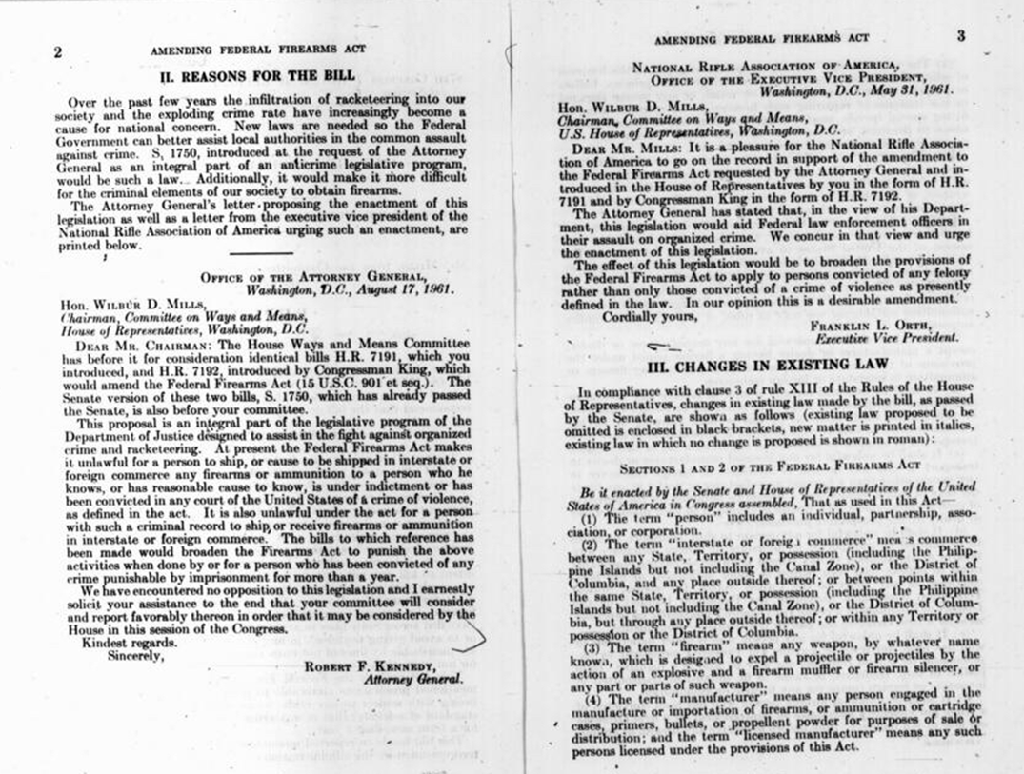
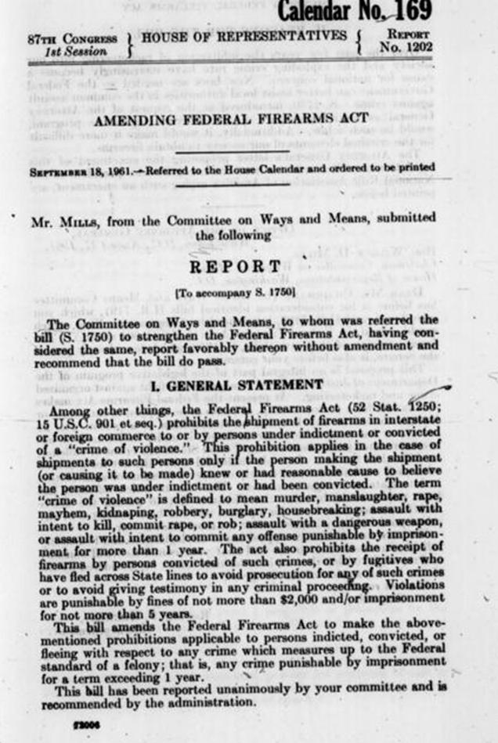

Slide 59
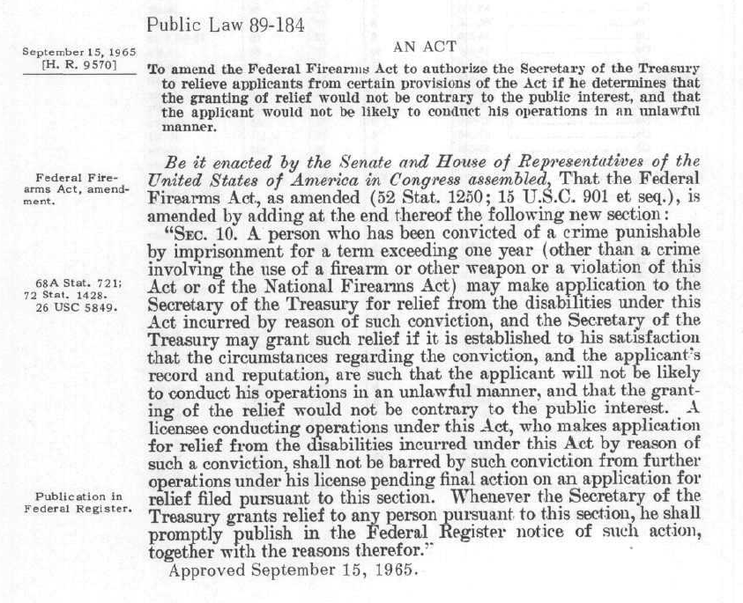

Slide 60

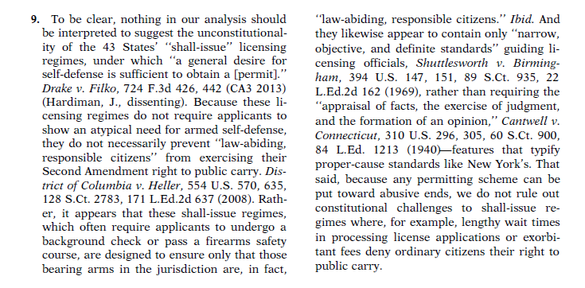
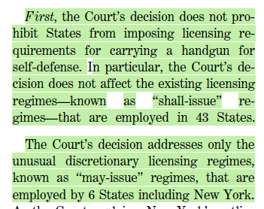

Slide 61
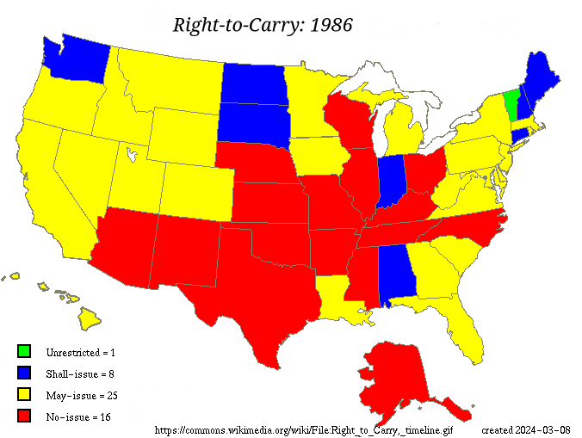

Slide 62

Source: ATF NICBCS 2022 Operational Report

Slide 63




Slide 64

Source: ATF NICBCS 2022 Operational Report

Slide 65


