Slide 1
Calculating and challenging criminal History
Cherrelle Herbert and Cristen Thayer
Notes:
CTH
Thank you, Omadare. Good morning, everyone! Thank you for inviting us to beautiful state of Mississippi. I am not exaggerating when I tell you we are so excited to be here.
My name is Cherrelle Herbert, I am one of the litigation attorneys at SRC. I am based out of the Virgin Islands, and I’m so thrilled to be joined by Cristen…. *Introduces herself*
Before we dive into criminal history, we’d like to talk a little bit about who we are and what we do at SRC.

Slide 2

National Sentencing Resource Counsel
Notes:
CTH
We, at SRC, work to provide support to federal public defenders and panel attorneys in the sentencing space. We are made up of four teams:
a Guidelines team – that works to fulfill the defender statutory obligation to comment at least annually on the work of the commission
a litigation team – that interacts most frequently with the defender community, either by sending out emails, responding to questions, collaborative briefing, or hosting office hours
a data team – that analyzes data to support defender litigation and policy positions
and a legislative team – that works most closely with defender detailees and other allies on the hill to make sure that the defender prospective is considered (though we do not and cannot lobby).
Under our newly minted director, and former SRC guidelines attorney, Leslie Scott, we work together and in collaboration with federal public defender offices to advance defender goals.
We manage several sentencing listservs – we have one national list, and several more content specific lists, for example we have a sentencing reduction list (which has been pretty active with litigation updates on the 2023 reduction in sentence amendment), we also have a bop litigation list, (which for example, has hosted discussion on FSA earned time credits.)
Additionally, every first and third Thursday at 1 PM Central, we host office hours! At office hours we frequently brainstorm emerging, complex, and hot topic sentencing issues. If you are interested in joining office hours, we will have a QR code at the end of this presentation.

Slide 3

Criminal History
SOC Upward Adjustments
Downward Departure Eligibility
BOP Custody Classification
Revocation Guideline Range
Criminal History Score
Offense Level
ACCA and CO Eligibility
Safety Valve Eligibility
Variance Under 18 U.S.C. § 3553(a)
Notes:
CTH
Turning now to the reason why we are here: criminal history.
We are all familiar with the impact our clients’ criminal history has on their criminal history score and ultimately their guideline range.
CLICK
But as we know, criminal history doesn’t just impact their score….. It impacts… so many things Including…
CLICK – READ the impacts – and this is a non-exhaustive list.

Slide 4
Offense level increases based on criminal history
Illegal Reentry Cases
§2L1.1(b)(3)
Firearms Cases
§2K1.3
Drug Cases
§2D1.1
Notes:
CTH
By way of example, we typically see increases in offense levels based on criminal history in our illegal reentry cases, our firearms cases, and our drug cases.
Which are most of our cases right, essentially our bread and butter.
So given the impact criminal history has on our client’s sentences and beyond, as practitioners we have to be both as diligent and as creative as we can to challenge the use of criminal history to increase our clients’ sentences.
***********
******
* Don’t read just FYI: Eligibility for certain SOC mitigating role adjustments (straw purchasers)

Slide 5
Roadmap
An Overview
The Basics
A Deeper Dive
Be Creative!
Notes:
CTH
So our hope is that today, we will flag some things to be on the lookout for, to help you in your diligence, and that we will spark some ideas to help foster your creativity.
To do that, we are going to start out with providing an overview of the basics. We will then take a deeper dive, and flag some things you should know, particularly some recent developments in the criminal history space. We will also share some ideas and practice tips for litigating criminal history.

Slide 6

Materials
Notes:
CTH:
As part of today’s presentation, you will receive a document with some resources we think will be useful as you challenge the application of criminal history points for your clients. We will share those resources with (Dean?), so he may share them with all of you.
Defender Comments and Guideline Amendments
2023 Guideline Amendments
2024 Guideline Amendments – Youthful
2023 Federal Defender Comments on the Proposed Amendments
2024 Federal Defender Comments on the Proposed Amendments

Slide 7
THE BASICS
Notes:
CCT

Slide 8

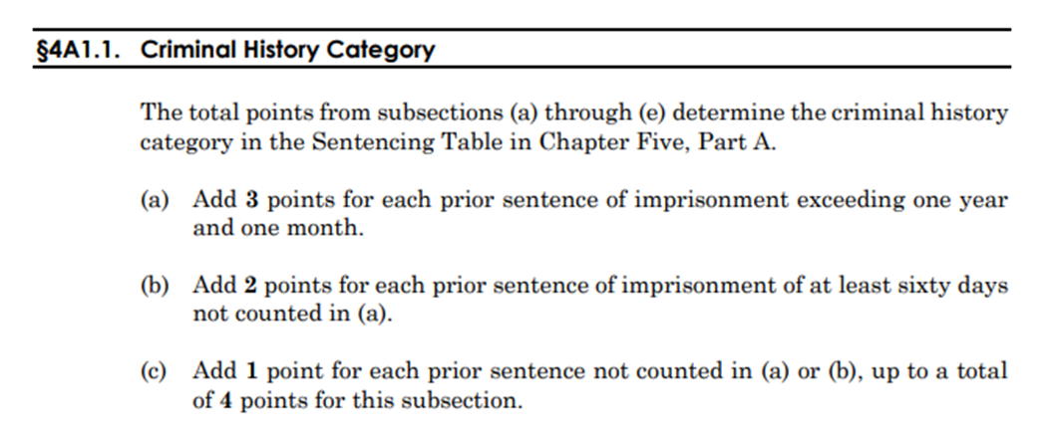
Basic framework
Notes:
CCT
Determined based on length of sentence imposed, and if a range then the maximum. NOT the actual time served. 4A1.2(b)

Slide 9
“Prior sentence” defined
(1) any sentence previously imposed upon adjudication of guilt
  guilty plea, trial, or plea of nolo contendere
(2) for conduct not part of instant offense
  i.e. relevant conduct under §1B1.3
Note: if conviction but no sentence yet, then one point if sentence “otherwise would have been counted”
Notes:
CCT
1. 4A1.2(a)(1)
2. 4A1.2(a)(1)
3. 4A1.2(a)(4)

Slide 10

“Adjudication of guilt” and
State Diversion Schemes
State offenses with diversionary dispositions counted only if “involved judicial determination of guilt or an admission of guilt in open court”
Make sure to research state sentencing schemes!
Notes:
CCT
4A1.2, app. n. 9; 4A1.2(f): Quirky state sentencing practices can affect whether the prior qualifies, make sure you look closely at what the state law required for any diversionary/suspended sentence priors. If they do not require admission of guilt, then they should not count

Slide 11

“Sentence of Imprisonment” Defined
If sentences imposed in the alternative, does not count as imprisonment
  Ex: $1,000 fine or 90 days
If part of carceral sentence suspended, only count portion not suspended
Notes:
CCT
4A1.2, app. n.4
4A1.1(c)

Slide 12

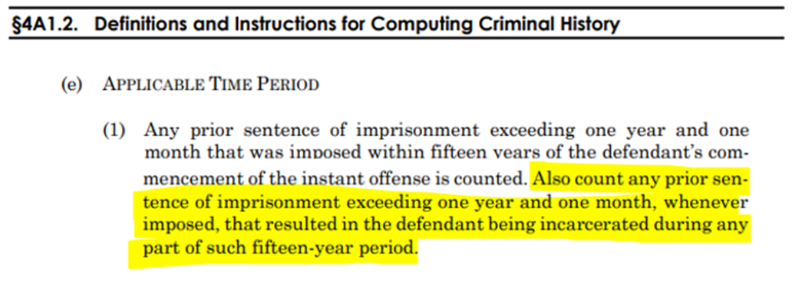
15-year lookback
Notes:
CCT
Sentence that exceeded one year and a month
Imposed within 15 years of instant offense OR when incarcerated within 15-year period
NOTE: this one actually turns on when person is incarcerated, not just max sentence imposed

Slide 13
Single-Sentence Rule
Either:
  Sentenced on same day
  Charges contained in same instrument
No intervening arrest between first and second offense
Notes:
CCT
4A1.2(a)(2):
When you have multiple sentences connected in some way, counted as single sentence if: sentenced on the same day, or charges in same instrument, and no intervening arrest
If concurrent, longest sentence controls; if consecutive, then aggregate sentence controls

Slide 14
Be on the lookout!
The Commission is considering amending §4A1.2 to define “arrest”.
The Commission will hold a public meeting on December 19th for the amendment cycle ending on May 1, 2025.
Notes:
CTH
Every year, the United States Sentencing Commission (the policy making body that created the guideline manual n- whose chair, Judge Carlton Reeves, sits right here in the SD of Miss). considers whether to promulgate any amendments to the guidelines manual.
On August 8th of this year, the Commission published its final priorities - which are essentially the issues it’s considering drafting amendments for – for the amendment cycle ending on May 1st.
Every year, as part of their ongoing commitment to resolve circuit conflicts that relate to the guidelines, the Commission includes some circuit conflicts as part of their priorities.
This year, the Commission has included a criminal history circuit conflict. Specifically, ***CLICK*** the Commission is considering whether to amend the guidelines to include a definition of what constitutes an arrest for the purposes of 4A1.2’s single sentence rule.
Currently, the 7th circuit has held that an arrest, for purposes of 4A1.2, can include a traffic stop that results in a citation or a summons but where the person was never formally placed in custody. Whereas all the other circuits to have decided the issue have held that an arrest must be a formal custodial arrest that does not include a traffic stop that results in the mere issuance of a summons/citation. Those circuits who have gotten it right, all of whom have addressed the issue more recently than the 7th, are the 3rd, 6th, 9th, 11th circuits.
To my knowledge, the 5th has not ruled on this issue – but if you have had to litigate what constitutes an arrest for the purposes of 4A1.2, I would love to talk to you.
CLICK - On December 19th, the Commission will hold a public meeting announcing what their proposed amendments will be for the 2025 amendment cycle, (so in about 13 days, but who’s counting) and we expect those proposed amendments will reflect the priorities they announced on August 8th, including this criminal history circuit conflict.
So, be on the lookout for that amendment!

Slide 15
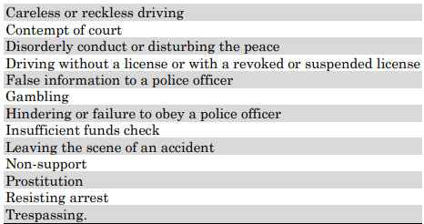
Excluding misdos/petties under §4A1.2(c)
Count these (or similar offenses) only if:
  (1) probation term more than a year or 30 days custody; or
  (2) prior offense similar to instant offense
Notes:
CCT

Slide 16
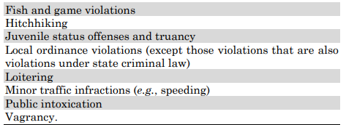
Excluding misdos/petties under §4A1.2(c)
Never count these (or similar offenses):
Notes:
CCT
4B1.1, 1.2

Slide 17

What makes an offense “similar”?
“Common sense approach,” non-exhaustive factors(!):
comparison of punishments imposed
perceived seriousness of offense as indicated by level of punishment
elements
level of culpability involved
degree to which commission of offense indicates likelihood of recurring criminal conduct
Notes:
CCT
Get creative with it!
4B1.1, 1.2

Slide 18
Career Offender
Requirements:
  18 years old
  instant offense COV/CSO
  two prior COV/CSO convictions
Automatically CHC VI
Notes:
CCT
4B1.1, 1.2—mandatory CH VI so very important to challenge this designation

Slide 19
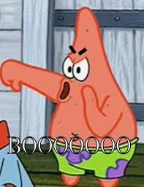
2023 Amendments:
Expanded robbery definition: now includes Hobbs Act robbery (and similar state statutes)
Moved definitions of robbery, forcible sex offense, extortion, and prior felony conviction from commentary to text
Moved language that includes inchoate offenses as a COV/CSO from commentary to text
Notes:
CCT
1.In response to many courts holding Hobbs Act robbery did not qualify as a COV under the pre-2023 CO guideline b.c the statute doesn’t fit the generic definition of robbery (similar rulings for a number of state offenses). Hobbs Act robbery and state robbery offenses that include force against property = Career Offender predicate
2. Limited ability to challenge commentary when it conflicts with/expands GL text
3. Addressed circuit conflict about whether the commentary provisions stating COV and CSO include inchoate offenses are controlling. The Comm moved the language that COV and CSO include aiding, attempt and conspiracy from the commentary to the GL text.

Slide 20

Still room for litigation!!
CSO should not include offers to sell
Drug overbreadth
Intentional mens rea for COVs
Notes:
CCT
1. Offers not covered by guideline text
2. State offense may criminalize more drugs than applicable federal definition if you are in a Circuit that uses the federal CSA schedules and not the state definition, but keep new Supreme Court decision Brown/Jackson in mind (a prior drug conviction counts as an ACCA predicate if it involved a drug on the federal schedule at the time of the state offense)
3. Borden v. United States, 141 S. Ct. 1817 (2021)-reckless not enough, so something more than that required

Slide 21
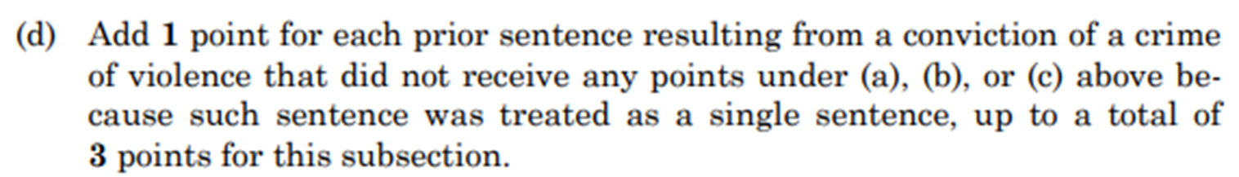

Don’t forget: Extra CH point for COVs not counted
Notes:
CCT
4A1.1(d)

Slide 22
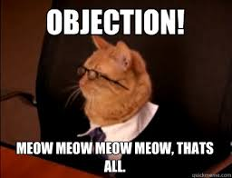
Preserving issues for appeal
Object to procedural errors after findings are made:
  erroneous factual findings, ignoring nonfrivolous § 3553(a) arguments, etc.
SOMETIMES: ok with record as is, but make sure intentional decision
Notes:
CCT
Sometimes it might be better to leave the record as is if you have a very unfavorable judge and they have made prejudicial/erroneous findings, and fight the issue on plain error on appeal (especially in 9th Circuit, for now). BUT this is an exception to the object always rule and make sure its tailored to the case and not routing

Slide 23

CH points on appeal
Remember to check (or re-check if doing own appeal) CH on appeal for plain error computation issues
If the error changes the CHC can generally meet plain error standards for reversal
Notes:
CCT
“When a defendant is sentenced under an incorrect Guidelines range—whether or not the defendant's ultimate sentence falls within the correct range—the error itself can, and most often will, be sufficient to show a reasonable probability of a different outcome absent the error.” Molina-Martinez v. United States, 578 U.S. 189, 198 (2016)

Slide 24

A DEEPER DIVE
Notes:
CTH:
Now, we are going to highlight some other things to know and keep a lookout for in your practice.

Slide 25

2023 Guideline Amendments
Notes:
CTH:
Beginning with the 2023 Guideline amendments

Slide 26
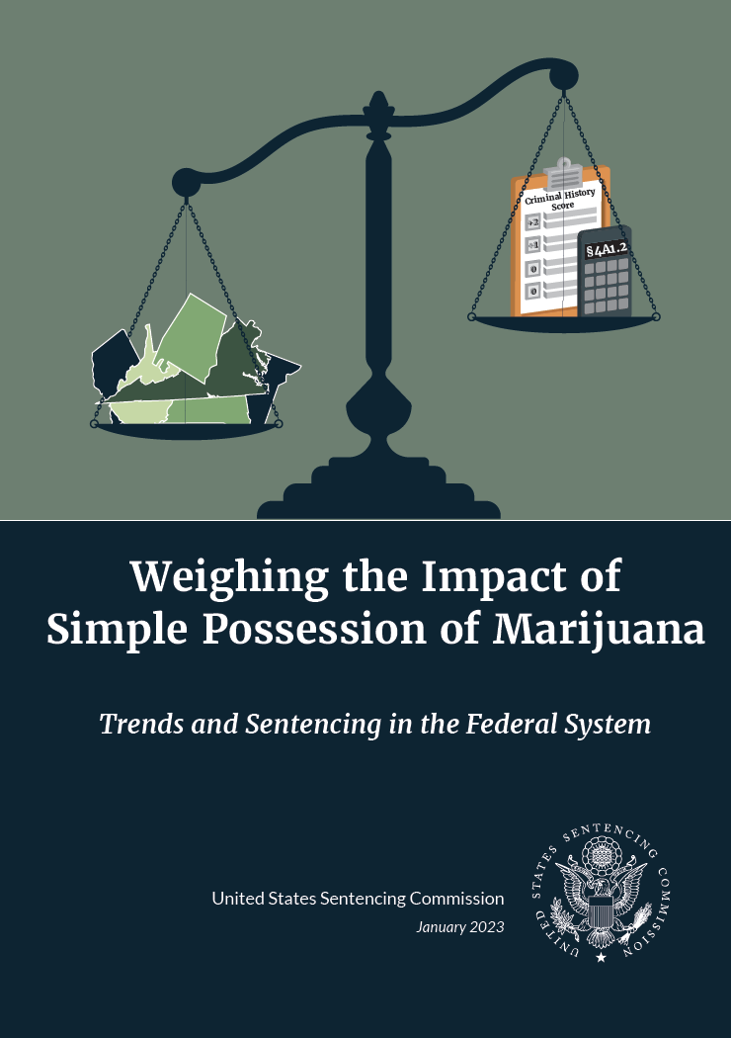
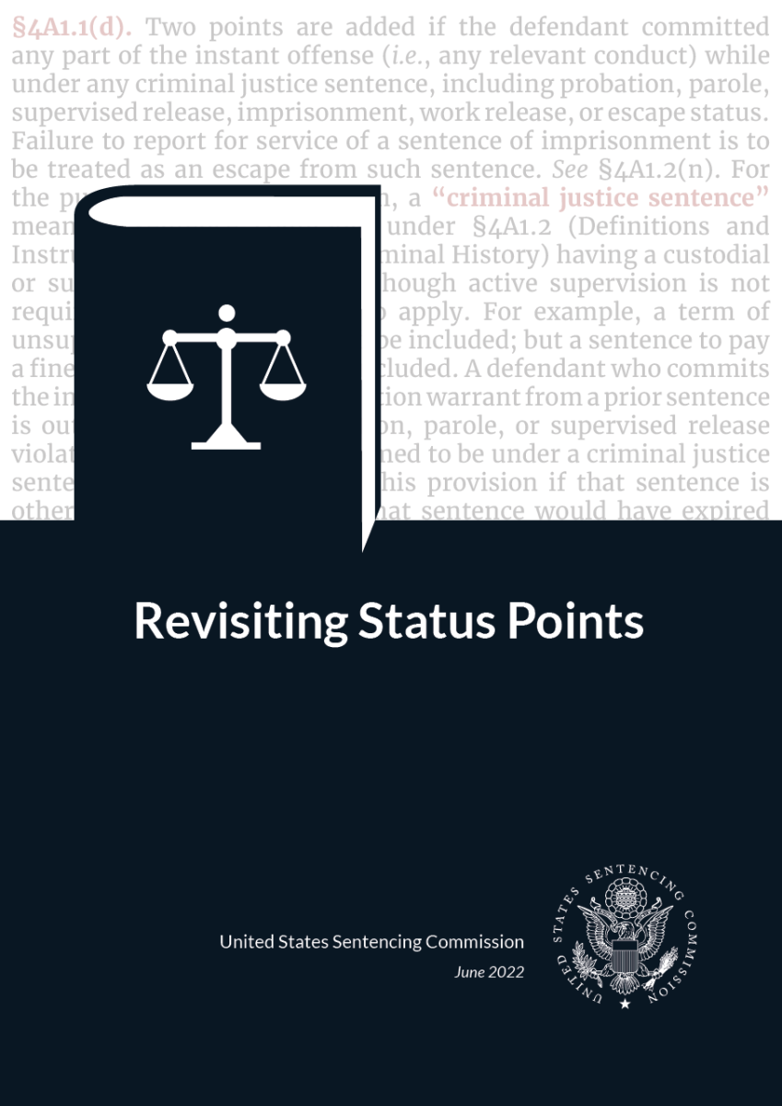
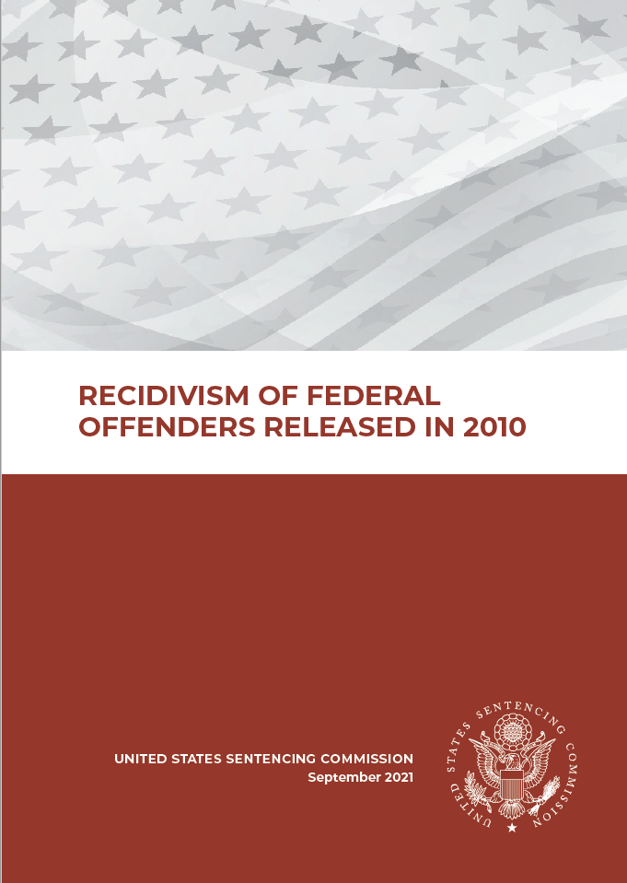
2023 Criminal History:
Guideline Amendments
Notes:
CTH
I’m not going to spend much time on these because I believe that last year at this conference, another SRCer presented on these amendments AND ..by now, you all are applying the 2023 amendments. But if you are interested in a more detailed training on the 2023 guideline amendment cycle, last year, Jayme Feldman and Leslie Scott did a fantastic webinar on the 2023 amendments. It’s available to all of you on FD.org. And while I’m on the topic of amendment overviews, this year, Leslie and Tina Woehr did a similar training on the 2024 amendments, that is also available on FD.org.
So, although we aren’t going to spend too much time on the 2023 amendments, since this is a criminal history training, and there were significant changes to the criminal history guidelines during the 2023 amendment cycle… it is worth flagging that last year the Commission promulgated three favorable parts to the criminal history amendment
. All of them are based on recidivism data and reports published by the Commission in the last few years.

Slide 27
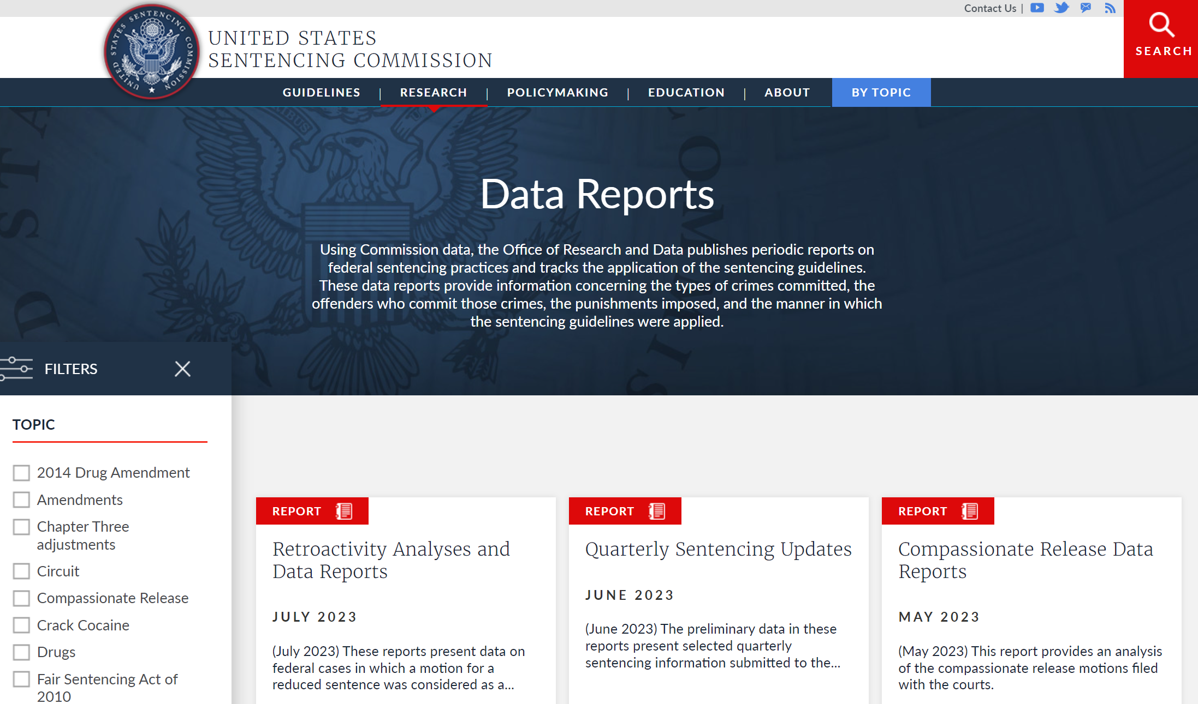

USSC DATA REPORTS
Notes:
CTH:
As a side note, if you’re not familiar with the Comm’s research reports, it’s worth spending some time on their website. While many reports are admittedly harmful to our clients, there is some useful data you can pull from and cite to, when making arguments for downward departures or variances.
This is a screenshot of the Commission’s DATA REPORTS Tab – found at USSC.org and their website is fairly user friendly.

Slide 28
2023 Guideline Amendments
Status Points
Eliminated status points for most of our clients
1 status point – if individual has 7 CH points or more
Zero-Point Reduction
2-level reduction for eligible individuals with zero criminal history points
There is a long list of limitations
Marijuana Downward Departure
Added departure language based on simple possession of marijuana
Notes:
CTH:
So, as a quick review, last year’s criminal history amendment did three things:
CLICK: First, it eliminated status points for most of our clients, now our clients only receive 1 status point – if they have 7 CH points or more.
CLICK: Second, the amendment created a 2-level reduction for eligible individuals with zero criminal history points, emphasis on the points. However, there is a long list of exclusions.
CLICK: And Third, the amendment added departure language based on simple possession of marijuana. Which we are going to return later in this presentation.

Slide 29
2024 Amendment: Zero-Point Reduction
2024 Guideline Amendment: Expanded two of the exclusions listed at §4C1.1(a)
Clarifying that an individual is ineligible for the §4C1.1 zero-point reduction if they have either an aggravating role or engaged in a continuing criminal enterprise. (§4C1.1(a)(10) and (a)(11)).
Striking the phrase “perpetrated against a minor” in the sex offense definition at §4C1.1(b)(2)
Notes:
CTH:
Now, I just mentioned that, that new language at 4C1.1, creating a 2-level reduction for certain clients, includes a long list of limitations or exclusions.
CLICK
However, like our colleague Adeel likes to say, because as defense attorneys we just can’t have nice things… during the 2024 amendment cycle the Commission already amended 4C1.1 by expanding two of the exclusions listed at 4C1.1(a)
CLICK
First, the Commission made what they are calling a “technical” amendment, clarifying that an individual is ineligible for an adjustment under 4C1.1, if that person either received an aggravating role adjustment or engaged in a continuing criminal enterprise
Second, the Commission struck the phrase “perpetrated against a minor” in the sex offense definition at 4C1.1(b)(2) – therefore expanding that limitation

Slide 30
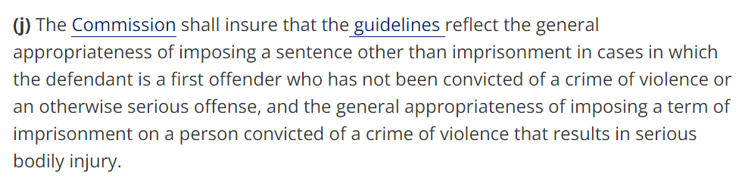
Practice Pointers: §4C1.1 Exclusions
Ex Post Facto!
28 U.S.C. § 994(j)
Notes:
So we do have some practice pointers for you:
First, don’t forget Ex post facto…
Normally we use the book in effect at the time of sentencing when calculating the guideline range.
But in general, if a person who already has an open and pending case, would be subject to a higher guidelines range if the 2024 manual applies – because of a new bad rule– that would violate the ex post facto clause and the guidelines say that you must apply the manual in effect on the date the offense was committed.
Now, I will just flag that the Commission has deemed at least one of the 2024 4C1.1 amendments to be a “clarifying amendment”, so the government may argue, and the court may rule that the ex post facto clause does not apply to that clarifying amendment. I really don’t know – but keep in mind that in general, when we have bad amendments – we should be considering whether we can challenge the new, higher, guideline calculation based on ex post facto.
Second, If you have a client with 0 CH points who is ineligible for the 4C1.1 reduction because of these exclusions, use 28 USC 994(j) to argue for a variance, and reference the Commission's data.
CLICK
Second, 994(j): is the statute that requires the commission to ensure that the guidelines reflect the general appropriateness of imposing a sentence other than imprisonment in cases involving 0 criminal history points. And though there are carveouts
994(j) DOES NOT LIMIT relief to specific zones; and, the Commission’s data, upon which this amendment is based, showing the low recidivism rate for individuals with zero CHC points, does NOT distinguish between those with or without the aggravators the Commission selected as carve outs.

Slide 31
Safety Valve Eligibility
Notes:
CTH:
Safety valve, refers to 18 USC § 3553(f)(1), limits the application of mandatory minimums and allows our clients to receive a reduction under the guidelines, in certain cases, if our clients meet certain criteria.
Prior to the First step act, clients were ineligible for safety valve if they had more than one criminal history point. However, the First step act changed that and developed new eligibility criteria
CLICK:

Slide 32
First Step Act: Safety Valve Eligibility
More than 4 CH points, excluding
1-point offenses;
Prior 3-point offense; and
Prior 2-point violent offense (defined in 18 U.S.C. § 16)
(or)
Notes:
CTH:
Here are the eligibility criteria following the first step act:
READ: Clients become ineligible to receive the safety valve if they have more than 4 CH points, excluding 1-point offenses; a prior 3-point offense; and a prior 2-point violent offense as defined in 18 U.S.C. 16
Many of you are probably very familiar with Pulsifer, so we are only going to touch on it briefly. But it is worth flagging, because thanks to Pulsifer, we now know that not only does “and” mean “and”, it also ***CLICK** means “or”

Slide 33

Pulsifer v. United States
Notes:
CTH:
Before the Supreme Court decided Pulsifer, the circuits were split on whether the first step act revisions to the criminal history requirement under 3553(f)(1) require a person to have satisfied all of the criteria to be ineligible for the safety valve, or whether an individual only needs to satisfy one of the criteria to become ineligible for safety valve.
In March of this year, in a 6-3 unfavorable ruling, SCOTUS held that the revisions to § 3553(f)(1)’s criminal-history requirement create an “eligibility checklist” and provide that an individual is ineligible for safety-valve relief if they meet any of the criminal history requirements.
As you know, in the 5th circuit, the day after Pulisfer was decided was just business as usual, because the 5th had taken the eligibility criteria approach even before SCOTUS did.
But if helpful, in your cases, you should be discussing safety valve eligibility in plea negotiations.

Slide 34
THE BOP
Notes:
Another area where our client’s criminal history can impact their eligibility is in their interactions with the BOP.
Our clients’ criminal history has the power to impact the length and harshness of the sentences our clients ultimately serve while in BOP custody.

Slide 35
BOP
Designation and Custody classification
FSA ETC
Second Chance Act Placements
Notes:
CTH:
CLICK: When our clients enter BOP custody, they receive a designation and custody classification. The custody classification determines the degree of staff supervision required for an individual and therefore determines their security level and ultimately impacts the type of facilities they will be designated to – which can impact the type of programming they have access to.
CLICK: Criminal history can also impact our client’s eligibility to earn time credits. Under 18 U.S.C. 3632(d)(4)(D)(li) – (51), a client’s prior conviction for certain serious violent felonies such as murder, sex abuse, and carjacking, can prevent our clients from earning time credits if they are also currently serving a sentence for certain serious violent felonies.
CLICK: Additionally, Prior convictions for certain violent offenses can also render our clients ineligible for second chance act early release placements
The list of serious violent felonies can at times seem arbitrary, not all the time but sometimes. So this is something you you pay close attention to the PSR for, and object to anything that is inaccurate.
You may also want to consider eligiblity as part of your plea negotiations, though you can’t change the priors, you can negotiate a better offense of conviction in a way that is not as harmful to our clients when combined with their criminal history.
Also, in the appropriate case, consider asking for a variance to account for your client’s ineligibility to earn time credits– though of course that is a very case specific suggestion, because you may not want to argue that a violent prior and violent instant offense should warrant a variance. In the right case you might.
And at minimum, this is something you should advise your client. Many of our clients get to prison and believe they will be earning time credits. They need to know when they will not be before they take a plea.

Slide 36
YOUTHFUL INDIVIDUALS
Notes:
CTH:
Tuning now to our youngest clients….this year the Commission amended the language of the 5H1.1 Policy Statement – addressing age.

Slide 37
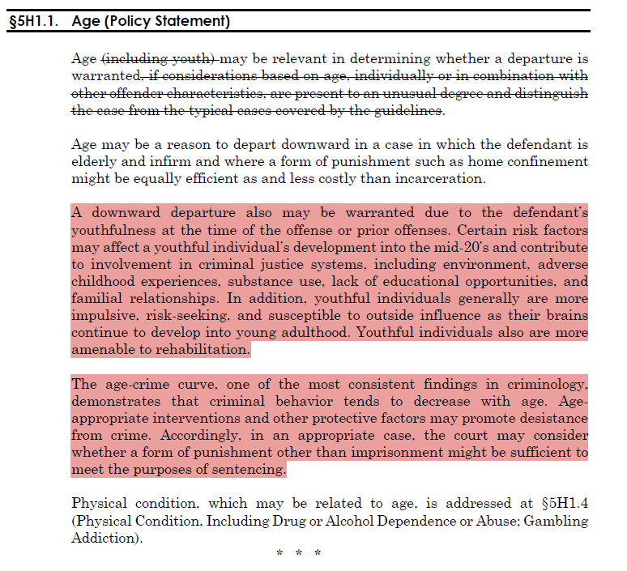
Stronger, more encouraging language to suggest downward departure or alternative to incarceration may be appropriate to account for youthfulness
Notes:
CTH
This is a screengrab of the amendment to the 5H1.1 policy statement. There is so much text on this slide I DO NOT expect you to read it, please don’t even try. I just wanted you to see what it looks like.
The policy statements in ch 5, part H discuss individual characteristics.
It describes encouraged, discouraged, and supposedly prohibited characteristics to consider in determining the appropriate sentence. However, many of the discouraged and prohibited factors conflict with the court’s obligations under Booker and 3553(a) to consider the history and characteristics of the individual being sentenced.
CLICK
The amendment provides stronger more encouraging language to suggest that a downward departure or an alternative to incarceration may be appropriate to account for youthfulness
I’d like to highlight two things
First, The amendment makes specific reference to youthfulness at either the time of the offense or (importantly for this presentation) during a prior offenses, highlighting some of the risk factors that may affect emerging adult development
Second, The new language also acknowledges that youthfulness extends beyond the teenage years!

Slide 38
Practice Pointers: Youthful Individuals
Request a downward departure under the §5H1.1 Policy statement in conjunction with §4A1.3 (overrepresented criminal history)
Highlight the racial disparities that persist
Be vigilant!
Notes:
CTH:
CLICK When representing our youngest clients, you should Request a downward departure under the §5H1.1 Policy statement in conjunction with 4A1.3 (overrepresented criminal history)
To do that, you can use the reasons for the amendments, defender comments, witness statements, witness testimony, which are all helpful resources
CLICK You can also highlight the racial disparities that persist CLICK
And BE VIGILANT

Slide 39

“Racial disparities in the criminal justice system are no accident, but rather are rooted in a history of oppression and discriminatory decision making that have deliberately targeted black people and helped create an inaccurate picture of crime that deceptively links them with criminality.”
- Vera Institute, An Unjust Burden: The Disparate Treatment of Black Americans in the Criminal Justice System (May 2018).
Notes:
CTH:
This is a quote taken from the Vera Institute, that READS…
This is particularly true for our youngest clients.

Slide 40
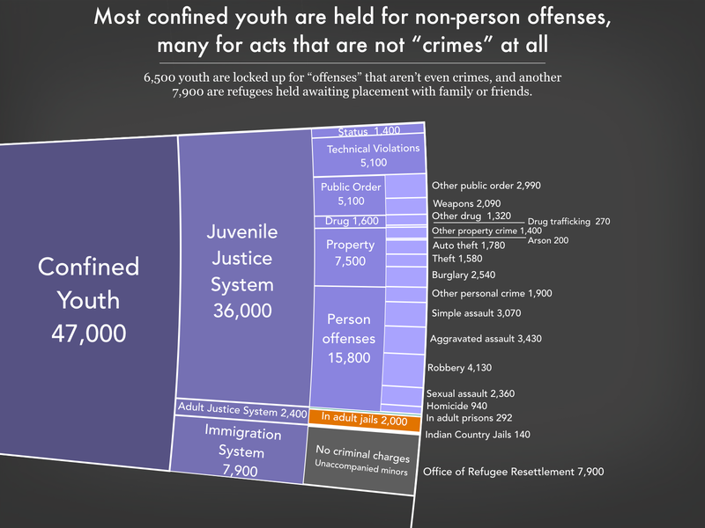
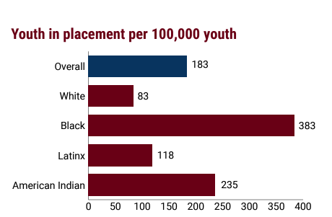
Notes:
CTH:
I’m going to share some data with you. This first graph is taken from the equal justice initiative… and shows that racial disparities in youth incarceration persist at alarmingly high rates.
CLICK
This second graph is taken from the prison policy initiatives and highlights that most confined youth are held for crimes where there is no victim, and many of them are confined due to status offenses that have the potential to spiral into other offenses.
So given what we know about what the data says, so please don’t hesitate to articulate this for your courts, you may be able to do that by moving for a departure under 4A1.3

Slide 41

§4A1.3 Overrepresented Criminal History
Notes:
CTH:
Speaking of 4A1.3 – let’s turn now to overrepresented criminal history.

Slide 42
§4A1.3 – Departures Based on Inadequacy of Criminal History Category
Upward Departures
4A1.3(a)(3) – Prohibition: Prior arrest itself insufficient under this guideline provision
Downward Departures
Reliable information indicates CHC substantially over-represents
Seriousness
Likelihood to recidivate
Notes:
CTH:
There are two helpful things we want to highlight under this guideline provision: 4A1.3 covers both upward and downward departures. CLICK In discussing upward departures, 4A1.3 provides examples of when an upward departure may be warranted – and includes, prior similar adult conduct not resulting in a criminal conviction. But there is a limitation…
CLICK 4A1.3(a)(3) notes that a prior arrest in and of itself insufficient under this guideline provision to justify an upward departure, and that’s just language you should be aware of
CLICK Secondly, we simply want to highlight what the downward departure provision requires: CLICK: It simply requires reliable information, that a client’s criminal history category overrepresents the seriousness and likelihood that our client will recidivate.

Slide 43
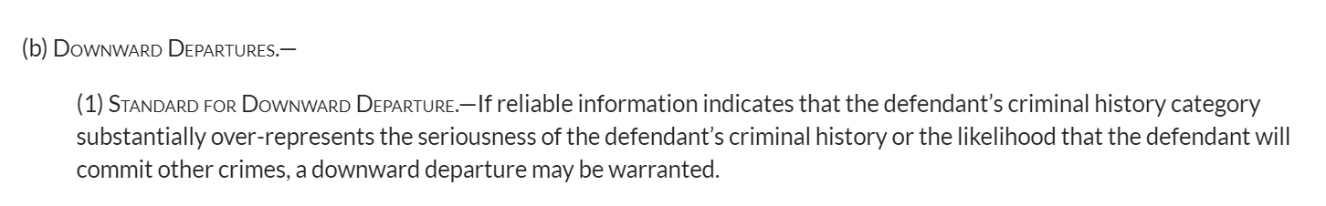
Notes:
CTH:
Here’s the downward departure language from 4A1.3(b)
***DO NOT READ– which says that if there is reliable information to show that our clients’ criminal history category over-represents the seriousness of their criminal history or the likelihood that they will commit other crimes, a downward departure may be warranted.

Slide 44
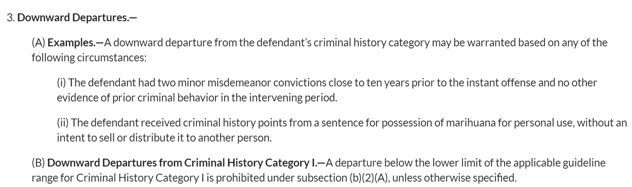
Notes:
CTH:
And here is the accompanying language at 4A1.3 application note 3 which provides examples of when a downward departure under this guideline may be warranted. You can see the specific reference to simple possession of marijuana in note 3(A)(ii)

Slide 45
In what other instances do you move for a downward departure under §4A1.3?
Notes:
CTH:
I’m curious and would like to hear from you..
Jurisdictional variations –
A lack of effective assistance of counsel.
The take away – talk to your client about their priors, they can share information that can lead to a sustained objection.

Slide 46
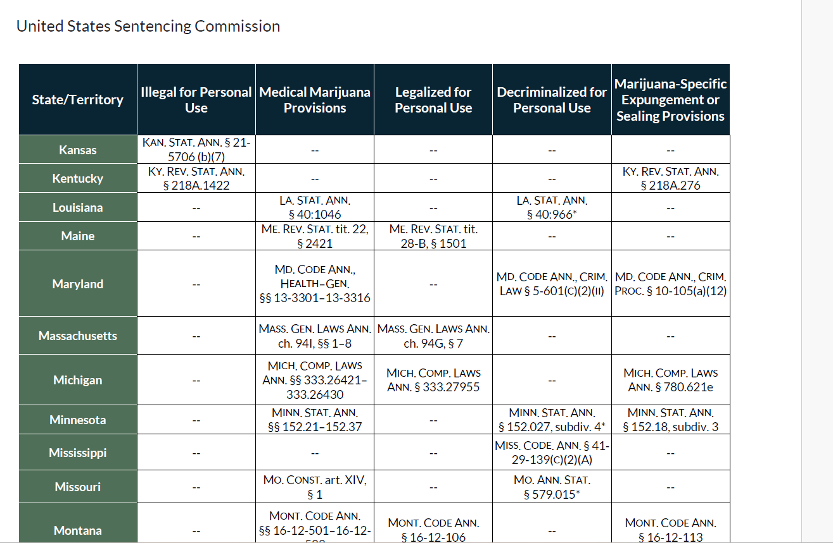
Notes:
CCT:
Chimes in on marijuana.

Slide 47

§4A1.3 Overrepresented criminal history
Notes:
CTH:
And really, when it comes to overrepresented criminal history our general philosophy is that you can ask for the moon!.... The sky is the limit. You are not at all limited to the examples provided in the application notes… 4A1.3 gives you an opportunity to provide the sentencing judge with context, an opportunity to tell a story, so seize it.
It’s important to remember that we are not married to these advisory guidelines… we at SRC spend a lot of time thinking about the guidelines, but even more important than the guidelines are our client’s stories, their individual characteristics. When you are done with your guideline analysis, and you’ve moved for a departure, ask for a variance under 3553(a)

Slide 48


Cherrelle_Herbert@fd.org
Cristen_Thayer@fd.org
Additional Resources:
SRC’s listservs – email us
SRC website: src.fd.org
Sentencing data resources
SRC Liaisons
SRC Office Hours
Office Hours signup
Notes:
CCT
End with list of SRC resources
SRC listserv with Commission, legislative, and litigation updates, email us to be added
Also have our website with lots of current and historical materials.
Data team plug, again
Revamped liaison program-get plugged into what is happening in each of the districts – CTH chimes in re Victoria McIntyre (SD Miss)
Office hours

Slide 49
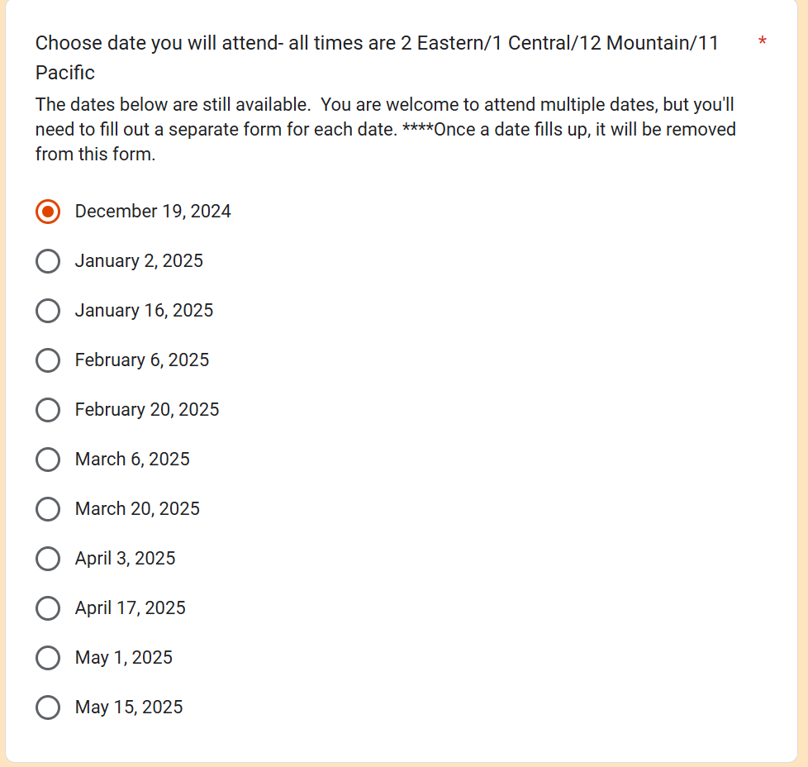
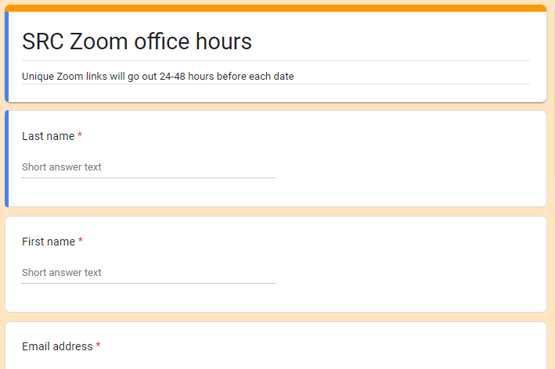
Litigation Support: Office Hours
Notes:
CTH
first and third Thursday at 2 pm eastern.
Informal setting to brainstorm sentencing related issues

Slide 50

THANK YOU!
Any questions?
Notes:
CCT and CTH

