Slide 1
Ethically Representing Clients Suffering from Mental Illness
CJA Panel Training Seminar SD MS, 2024
Richard Bourke, Director, Louisiana Capital Assistance Center

Slide 2
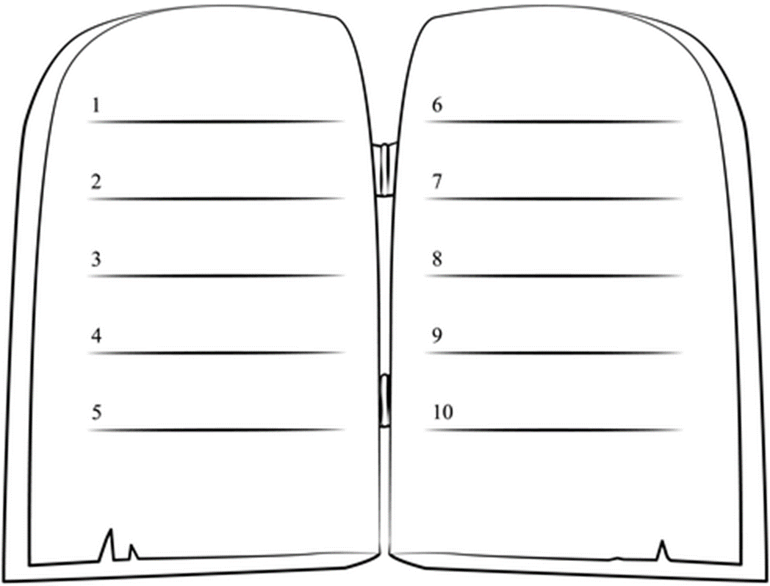
Thou shalt not place some other moral code above the rules of professional conduct
Thou shalt not kill your client by failing to investigate or failing to understand their mental illness
Thou shalt not spout off about competence or mental illness without knowing what you are talking about
Thou shalt not steal ideas and pleadings from other cases without adapting them to your client’s unique situation
Thou shalt remember to take breaks and look after your own mental health and that of your team
Thou shalt not bear false witness about your client’s competence or lack thereof
Thou shalt not screw your client by treating them as nothing more than their mental illness
Thou shalt not bow down to any judges, psychiatrists, psychologists or prosecutors
Thou shalt interview the mother and father, but also conduct a comprehensive investigation of collateral witnesses and sources
Thou shalt not kill your client by failing to investigate or failing to understand their mental illness
Thou shalt not covet your colleague’s sane client
Thou shalt not place some other moral code above the rules of professional conduct
Thou shalt not bow down to any judges, psychiatrists, psychologists or prosecutors
Thou shalt not screw your client by treating them as nothing more than their mental illness
Thou shalt not spout off about competence or mental illness without knowing what you are talking about
Thou shalt not steal ideas and pleadings from other cases without adapting them to your client’s unique situation
Thou shalt remember to take breaks and look after your own mental health and that of your team
Thou shalt not bear false witness about your client’s competence or lack thereof
Thou shalt interview the mother and father, but also conduct a comprehensive investigation of collateral witnesses and sources
Thou shalt not covet your colleague’s sane client
Our Ten Commandments

Slide 3
Thou shalt not treat a competent client as if they are incompetent
Thou shalt not treat an incompetent client as if they are competent

Slide 4
Ethical obligations FOR ALL CLIENTS
Rule 1.1 Attorney Competence
Rule 1.2 Scope of representation
Rule 1.4 Communication
Rule 1.6 Confidentiality

Slide 5
Rule 1.1 Attorney Competence
legal knowledge & skill
thoroughness & preparation
consider the relative complexity and specialized nature of the matter. Can obtain training or associate with skilled counsel.
ABA guidelines – a qualified member of the team

Slide 6
Rule 1.2 Scope of representation
(Control)
Abide by:
  Objectives of representation
  Plea to be entered
  Whether client will testify
  [Penalty phase presentation]
Consult
  means by which the objectives are to be achieved

Slide 7
Rule 1.4 Communication
Inform sufficiently for informed consent as needed
Keep reasonably informed about status of a matter
Promptly comply with reasonable requests for information
Reasonably consult about the means to achieve objectives
Fully informing may be impracticable where mental disability: counsel may temporarily withhold where possible harm to client (e.g. psychiatric diagnosis)

Slide 8
Rule 1.6 Confidentiality
A lawyer shall not reveal information relating to the representation of a client unless the client gives informed consent but
  disclosure is impliedly authorized in order to carry out the representation
  disclosure permitted if reasonably necessary to prevent reasonably certain death or substantial bodily harm;

Slide 9
Ethically representing a mentally ill but competent client

Slide 10
Rule 1.14 Client under a disability
Diminished capacity to make adequately considered decisions: not the same as the competence standard
Maintain normal client-lawyer relationship, as far as reasonably possible
Take reasonably necessary protective action to prevent harm where client cannot act in own interests
Implied authorization to disclose confidential information to take protective action: “but only to the extent reasonably necessary to protect the client's interests.”

Slide 11
Reasonably Necessary Protective Action
  Consult those that can take protective action;
  Seek guardian ad litem, conservator or guardian
  Also
    consulting with family members;
    reconsideration period
    voluntary surrogate decision making tools such as durable powers of attorney
    consulting with support groups, professional services, adult-protective agencies or other individuals or entities that have the ability to protect the client

Slide 12
Considerations in Reasonably necessary protective action
  Wishes and values of the client to the extent known
  Client’s best interests
  Intruding into the client’s decisionmaking autonomy to the least extent feasible
  Maximizing client capacities
  Respecting the client’s family and social connections.

Slide 13
identifying & understanding mental illness
Simple things to look for and track
Learn to understand your client’s experience of mental illness

Slide 14
Simple things to look for and track
  Grooming and hygiene
  Body language
  Affect
  Clothing and makeup
  Interactions with others
  Communication
  Speech
  Speech/thought process
  Thought content
  Mood
  Intellectual Functioning
  Pre-arrest context
    Home
    Arrest
    Interactions
    behavior
  Obtaining mental health history
  Substance use history
  Trauma

Slide 15
Understand your client’s experience of mental illness
Anosognosia & lack of insight
Delusions & over-valued ideas
Hallucinations
Disorganized thought and speech
Trauma & traumatic reactions
Mood – depression, mania, mood swings
Anxiety, paranoia, grandiosity
Cognitive impairment
Co-morbidity with drug use

Slide 16
Communicating & Partnering
Structural obstacles to communication
Tools for communication and partnering

Slide 17
Structural obstacles to communication with the mentally ill client
Optimal
Courts and prisons
Low stress
Few distractions
Safe and Calm
Take your time
Observe as well as listen
Relationship
Identifying what the client wants & needs
Very high stress
Many distractions
Client is under threat and in an elevated mood
Hurried encounters
Physically constrained environments – video, cuffs, wire mesh
Limited contact, relationship or trust
Want something from the client

Slide 18


Tools for communication and partnering
ALL team members should be trained to communicate and partner with seriously mentally ill clients
LEAP method – especially with psychosis

Slide 19
Tools for communication and partnering
  Listen: listen reflectively to delusions, ansognosia, desires
  Empathize: express empathy – normalize feelings (I would feel same if . . .)
  Agree: Discuss perceived problems/goals/costs/benefits
  Partner: Partner on goals - - - don’t rush to your goals
  Delay: delay your opinion
  Opinion 3A’s: Apologize, acknowledge fallibility, agree to disagree

Slide 20
When is the line crossed to incompetence
  The test must be whether he has sufficient present ability to consult with his lawyer with a reasonable degree of rational understanding -- and whether he has a rational as well as factual understanding of the proceedings against him.
Dusky v. United States, 362 U.S. 402, 402 (1960)
  It has long been accepted that a person whose mental condition is such that he lacks the capacity to understand the nature and object of the proceedings against him, to consult with counsel, and to assist in preparing his defense may not be subjected to a trial.
Drope v. Missouri, 420 U.S. 162, 171 (1975)

Slide 21
Ethically representing an incompetent client
We cannot ethically represent an incompetent client at trial
But we don’t get to adjudicate incompetence. So:
We need to understand and investigate competence
Dealing with mental health assessments

Slide 22
Understanding and investigating incompetence
We need to conduct an investigation that:
  Establishes a mental condition/“mental disease or defect”
  Establishes an inability to consult with counsel with a reasonable degree of rational understanding;
  Eliminates malingering
A thorough investigation of documentary, lay and expert evidence across the course of the client’s life and culminating in the client’s current functioning as it relates to competence.

Slide 23
The defense mental health Expert
Using consulting experts
  To understand what you are seeing and what to investigate
  To improve communication
Using a testing expert
  Not within privilege
  Managing the test parameters
Using a testifying expert
    Challenging the finding

Slide 24
Dealing with mental health assessments
Understanding the psychological and psychiatric assessments that are used
Access to raw test data from psychometric tests

Slide 25
Understanding the psychological and psychiatric assessments
Must know the waiver our client will be asked to give
Must know the instruments being administered to our clients: content, limitations, strengths and weaknesses
There is no test of competence
Some competency screening instruments provide normative data or highlight areas for further clinical exploration
The main ones all involve a subjective component in scoring

Slide 26
Understanding the psychological and psychiatric assessments
GCCT: Georgia Court Competency Test
MacCAT-CA: MacArthur Competence Assessment Tool–Criminal Adjudication
ECSTR: Evaluation of Competency to Stand Trial

Slide 27
Understanding the psychological and psychiatric assessments
None of the tests are designed for assessing the particular competencies in a capital case
Many psychologists do not have a deep understanding of the instruments
Non-standardized administration and errors are not uncommon
Protective measures re: testing of the client should be sought – See example in materials

Slide 28
Access to raw test data from psychometric tests
We must obtain and review raw test data and materials
    errors in recording responses;
    scoring errors;
    misapplication of scoring rules;
    non-standardized testing methods;
    impeachment of conclusions to be drawn from test results;
    undisclosed evidence of incompetence.

Slide 29
Access to raw test data from psychometric tests
It is not sufficient for your psychologist to see the results
    Don’t trust psychologists to critique psychology
    Only you will have sufficient information about your client and your case
    Right to effective assistance of counsel
It is just as important to see your own expert’s test data

Slide 30
Access to raw test data from psychometric tests
Psychologists, test publishers and neuropsychs are mobilized to oppose access – see article in materials
    Test security
    Misinterpretation of results
    Copyright & Trademark
    Coaching by attorneys
Obtain access with a protective order – see example
It is unethical to coach a client to beat a psych test!

Slide 31
Ethical representation after your client is found incompetent
Keep working the case
Rule 1.14 continues to govern the relationship
Maintain contact and continue to investigate competence
Do not expect gratitude from a client lacking insight
  empathize with your client’s subjective experience of betrayal, persecution and trauma
  Use your skills in communication to rebuild your relationship

Slide 32
Remember the 4 pillars and respect your client’s inherent dignity as a human being
Competence
Control
Communication
Confidentiality

